Slide 1
Healthcare Facility Response to Candida auris

Slide 2
Learning Objectives
List two examples of potential risk factors for developing Candida auris.
Describe two important infection control measures for managing Candida auris cases.
Explain one difference in response recommendations for healthcare facilities with Candida auris cases.

Slide 3
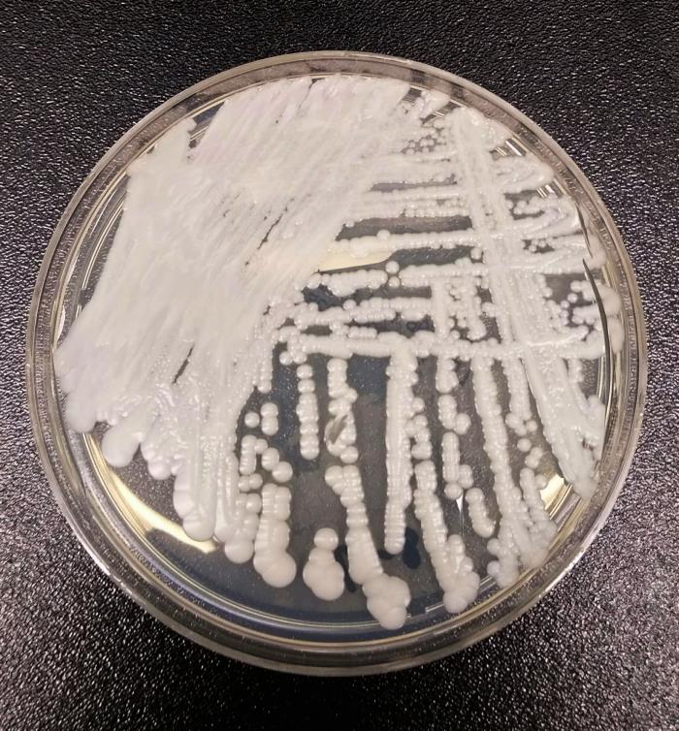
Overview of Candida auris

Slide 4
What is Candida auris?
Candida auris (also written as C. auris) is a fungus that causes severe infections.
C. auris was first identified in 2009 in Japan.
First reported in the United States in 2016.
Notes:
Healthcare facilities in several countries have reported that a type of yeast called Candida auris has been causing severe illness in hospitalized patients.
CDC considers C. auris an emerging pathogen because increasing numbers of infections have been identified in multiple countries since it was recognized.
In June 2016, CDC issued a clinical alert describing the global emergence of C. auris and requesting that laboratories report C. auris cases and send patient samples to state and local health departments and CDC.
Thirteen cases of Candida auris (C. auris) were reported in November of 2016 – Seven of the cases occurred between May 2013 and August 2016, and six of them were identified through retrospective review.
Patients with C. auris were reported in New York, Illinois, Maryland, and New Jersey.
(Centers for Disease Control and Prevention, 2016)

Slide 5
Current State of C. auris
Tracking Candida auris | Candida auris | Fungal Diseases | CDC
(Centers for Disease Control and Prevention, 2023)

Slide 6
Why are we concerned?
(Soda, Forsberg, & Jones, 2021)
Notes:
It’s often resistant to medicines. Antifungal medicines commonly used to treat Candida infections often don’t work for Candida auris. Some C. auris infections have been resistant to all three types of antifungal medicines.
It causes serious infections. C. auris can cause bloodstream infections and even death, particularly in hospital and nursing home patients with serious medical problems. More than 1 in 3 patients with invasive C. auris infection (for example, an infection that affects the blood, heart, or brain) die.
It can spread in hospitals and nursing homes. C. auris has caused outbreaks in healthcare facilities and can spread through contact with affected patients and contaminated surfaces or equipment. Good hand hygiene and cleaning in healthcare facilities is important because C. auris can live on surfaces for several weeks.
Also of note: It’s difficult to identify. C. auris can be misidentified as other types of fungi unless specialized laboratory technology is used. This misidentification might lead to a patient getting the wrong treatment.
(Centers for Disease Control and Prevention, 2021)

Slide 7
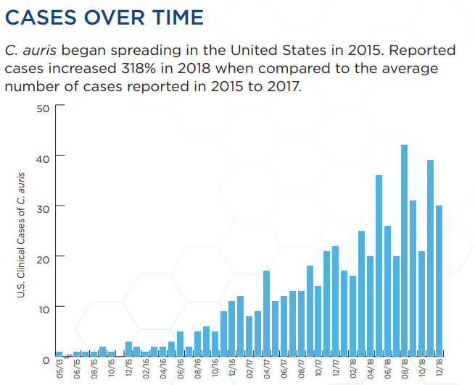
Infections caused by C. auris
Causes invasive infections:
Bloodstream infections
Wound infections
Ear infections
Also isolated from:
Respiratory specimens
Urine specimens
(Centers for Disease Control and Prevention, 2021)
Month & Year of Clinical Cases of C. auris
Notes:
C. auris can cause bloodstream and other types of invasive infections.
Targets patients in hospitals and nursing homes which have multiple medical problems.
Invasive infections with any Candida species can be fatal – We don’t know if patients with invasive C. auris infection are more likely to die than patients with other invasive Candida infections.
More than 1 in 3 patients die within a month of being diagnosed with an invasive C. auris infection.
Based on information from a limited number of patients, 30–60% of people with C. auris infections have died. (However, many of these people had other serious illnesses that increased their risk of death.)
It also has been isolated from respiratory and urine specimens, but it is unclear if it causes infections in the lung or bladder.
(Centers for Disease Control and Prevention, 2019)
(Centers for Disease Control and Prevention, 2021)

Slide 8
Who is at risk for C. auris?
People who have recently spent time in hospitals or nursing homes and have lines and tubes that go into their body.
Infections have been found in patients of all ages, from preterm infants to the elderly.
Notes:
People who have recently spent time in hospitals and nursing homes, particularly vSNFs and LTACHs, and have invasive devices (e.g., mechanical ventilation or tracheostomy, feeding tubes and central venous catheters) seem to be at the highest risk for C. auris infection.
Limited data suggest that the risk factors for Candida auris infections are generally similar to risk factors for other types of Candida infections – These risk factors include recent surgery, diabetes, broad-spectrum antibiotics, and antifungal use.
Further study is needed to learn more about risk factors for C. auris infection.
(Centers for Disease Control and Prevention, 2019)

Slide 9
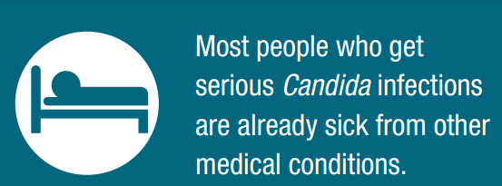
Who is at risk for C. auris? (continued)
Received healthcare in post-acute care facilities (e.g., nursing homes), especially those with ventilator units.
Recently hospitalized outside the United States, especially in countries with known C. auris cases.
Infected or colonized with carbapenemase-producing bacteria.
Notes:
Know which patients are at higher risk for C. auris infection or asymptomatic colonization.
(visit www.cdc.gov/fungal/ candida-auris for a map of countries),

Slide 10
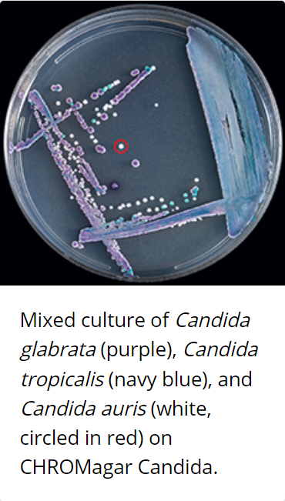
How is C. auris identified?
Usually diagnosed by culture of blood or other body fluids.
Harder to identify from cultures.
Requires specialized laboratory methods.
(Centers for Disease Control and Prevention, 2020)
Notes:
C. auris is harder to identify from cultures than other, more common types of Candida.
It can be confused with other types of yeasts, particularly Candida haemulonii.
Special laboratory tests are needed to identify C. auris.
Correctly identifying C. auris is critical for starting measures to stop its spread and prevent outbreaks.
(Centers for Disease Control and Prevention, 2020)

Slide 11
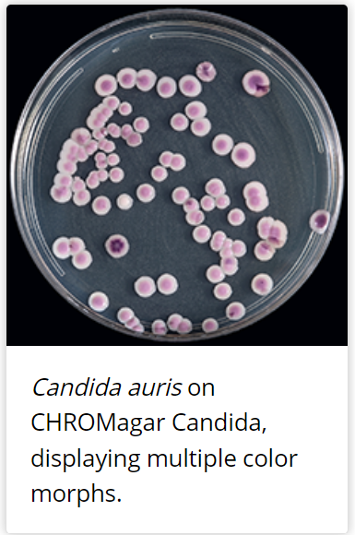
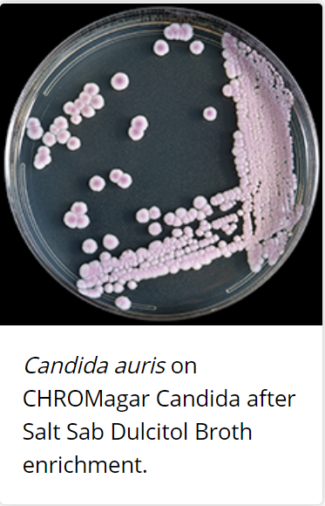
Identification of C. auris
C. auris can be misidentified as several different organisms.
Notes:
C. auris can be misidentified as a number of different organisms when using traditional phenotypic methods for yeast identification such as VITEK 2 YST, API 20C, BD Phoenix yeast identification system, and MicroScan.
The appearance and color of C. auris colonies in culture may aid in species identification, but cannot be used as the only identification method for C. auris since C. auris cannot be distinguished from other more common species of Candida without using other methods.
C. auris is a budding yeast, which almost never forms short pseudohyphae and does not form germ tubes.
(Centers for Disease Control and Prevention, 2020)

Slide 12
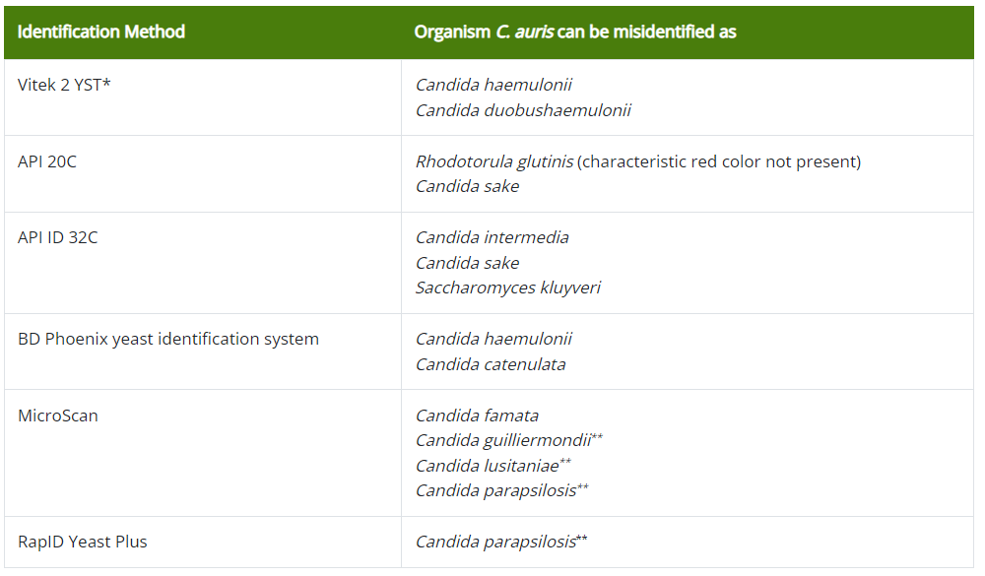
Misidentifications of C. auris
https://www.cdc.gov/fungal/ candida-auris/identification.html
Notes:
This table summarizes common misidentifications based on the identification method used. If any of the species listed below are identified, or if species identity cannot be determined, further characterization using appropriate methodology (see “How to identify Candida auris“) should be sought.
This table is adapted from information provided by CDC: https://www.cdc.gov/fungal/ candida-auris/identification.html
Please note that this list is based on current knowledge about C. auris misidentification.
It may change from time to time as we learn more about the misidentification of C. auris.

Slide 13
When to suspect C. auris
Increase in infections due to unidentified Candida species.
Including increases in isolation of Candida from urine specimens.
Risk factors associated with C. auris are present.
Notes:
An increase in infections due to unidentified Candida species in a patient care unit, including increases in isolation of Candida from urine specimens, should also prompt suspicion for C. auris since C. auris can be transmitted in healthcare settings.
Risk Factors for C. auris include: (Sikora & Zahra, 2022)
Presence of a central venous catheter
Indwelling urinary catheter
Immunosuppressive state (human immunodeficiency virus, hematologic malignancy, solid tumors, transplant recipients, neutropenia, chemotherapy, corticosteroid therapy)
Diabetes mellitus
Chronic kidney disease
Exposure to broad-spectrum antibiotics or previous exposure to antifungal agents within 30 days
Concomitant bacteremia or candiduria
Parenteral nutrition
Blood transfusion
Hemodialysis
Surgery within 30 days
Admission to intensive care units

Slide 14
Colonization vs. Infection
Patients can carry C. auris somewhere on their body, even if it is not making them sick. This is called colonization.
Patient’s can develop an active infection of C. auris when the organism enters the body. Symptoms can vary.
After an active infection, colonization can last for several months.
Infection control measures are the same for both infection and colonization with C. auris.
Notes:
C. auris can colonize patients’ skin and other body parts months after active infection has resolved.
C. auris can cause invasive infection (e.g., bloodstream, intra-abdominal) requiring antifungal therapy.
It has also been found in noninvasive body sites and can colonize a person without causing an active infection.
These sites include urine, external ear canal, wounds, and respiratory specimens.
Because C. auris has also been found on the skin, a screening swab can determine colonization.
Patients have been found to be colonized for several months after active infection has resolved – we don’t know the maximum amount of time that a patient can be colonized.
There are currently no data on the efficacy of decolonization for patients with C. auris, such as the use of chlorhexidine or topical antifungals.
(Centers for Disease Control and Prevention, 2021)

Slide 15
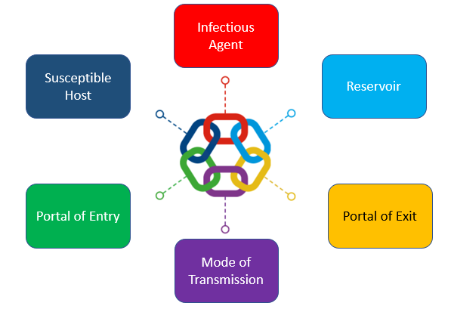
Transmission of C. auris
Contact with contaminated environmental surfaces & equipment.
C. auris can survive on surfaces for weeks.
It can withstand commonly used healthcare facility disinfectants.
Direct person-to-person contact
Notes:
The chain of infection consists of 6 links that can be broken at any point through prevention and control measures:
Infectious agent: bacteria, virus, fungi (i.e. Candida auris), or parasites. Broken through diagnosis and treatment and antimicrobial stewardship
Reservoir: dirty surfaces and equipment, people, water, animals/insects, soil. Broken through cleaning and disinfection and sterilization, IPC policies, pest control
Portal of exit: open wounds/skin, splatter of body fluids, aerosols. Broken through hand hygiene, personal protective equipment, control of aerosols, respiratory etiquette, waste disposal
Mode of transmission: contact (direct or indirect), ingestion, inhalation. Broken through hand hygiene, PPE, food safety, cleaning/disinfection, isolation
Portal of entry: broken skin/incisions, respiratory tract, mucous membranes, catheters and tubes. Broken through hand hygiene, PPE, personal hygiene, first aid, removal of catheters and tubes
Susceptible host: any person, especially those receiving healthcare. Broken through immunizations, treatment of underlying disease, health insurance and patient education
In the case of C. auris:
C. auris can be transmitted in healthcare settings and cause outbreaks.
It can colonize patients for many months, persist in the environment, and withstand some commonly used healthcare facility disinfectants.
C. auris can spread in healthcare settings through contact with contaminated environmental surfaces or equipment or from person to person.
Transmission is not thought to occur via persistent colonization of healthcare workers.
(Centers for Disease Control and Prevention, 2020)

Slide 16
C. auris in Pennsylvania
The CDC defines criteria for different categories of organisms and resistance mechanisms through Tiers and recommends approaches for each.
Tier 1 – organisms or resistance mechanisms that have never (or very rarely) been identified in the United States and for which experience is extremely limited.
Tier 2 – organisms that are primarily associated with healthcare settings and are not commonly identified in the region, have no existing treatment options, and that have the potential to spread more widely within a region.
Tier 3 - organisms targeted by the facility or region for epidemiologic importance that have been identified frequently across a region, indicating advanced spread, but are not considered endemic.
Tier 4 - organisms are endemic in a region.
C. auris is a Tier 2 organism in Pennsylvania.

Slide 17
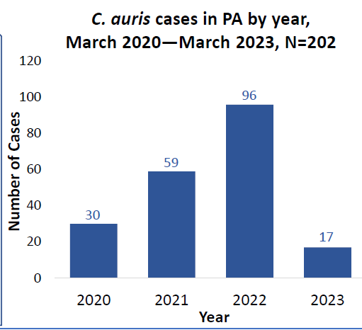
C. auris in Pennsylvania
First confirmed case in March 2020.
202 cases of C. auris infection and colonization have been identified in patients in 31 healthcare facilities across the state as of March 2023.
Notes:
Current Status in PA
In the southeast region, C. auris has been detected in over 50% of the ventilator-capable skilled nursing facilities (vSNFs) and long-term acute care hospitals (LTACHs) serving high-risk patients, and many of these facilities have experienced further transmission.
While the majority of C. auris cases remain concentrated in southeastern PA, recently detected cases in central and western PA indicate that healthcare facilities across the state should be on alert for C. auris.

Slide 18
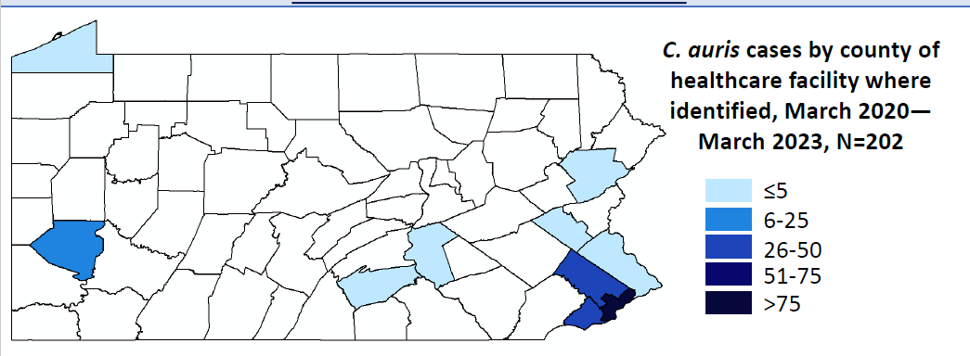
C. auris in Pennsylvania
*Data for 2023 is not finalized; year-to-date count as of March 31, 2023

Slide 19
Health Alerts in Pennsylvania
PAHAN – 687 UPDATE: Outbreak and Containment of Candida auris in PA Healthcare Facilities
PAHAN – 654 UPDATE: Outbreak and Containment of Candida auris in PA Healthcare Facilities
PAHAN – 584 UPDATE: Outbreak and Containment of Candida auris in PA Healthcare Facilities
PAHAN – 573 UPDATE: New Outbreak and Containment of Candida auris in PA Healthcare Facilities
PAHAN – 522 ALERT: New Outbreak and Containment of Candida auris in PA Healthcare Facilities

Slide 20
Adherence to ICP Measures
Education
Availability of adequate supplies
Monitoring
Appropriate signage
Alerts
Notes:
Educate all healthcare personnel about C. auris and the need for appropriate precautions. Given the potential for environmental spread of this fungus, include personnel involved in environmental services, activity programs, and dietary services, as well as other healthcare personnel without routine direct patient contact. Follow-up education may be needed to reinforce concepts and to account for healthcare personnel changes and guidance updates.
Ensure that adequate supplies (i.e., alcohol-based hand sanitizer, gowns and gloves, and cleaning and disinfection agents) are available to implement and maintain appropriate infection control measures.
Monitor for adherence to appropriate infection control practices by performing audits and providing feedback on hand hygiene practices, donning and doffing of gowns and gloves, and environmental cleaning and disinfection. Consider increasing the number of audits performed on units with C. auris cases.
Ensure that an appropriate sign is present on the patient’s door to alert healthcare personnel and visitors of recommended precautions.
Flag the patient’s record to alert healthcare personnel to institute recommended infection control measures in case of readmission.

Slide 21
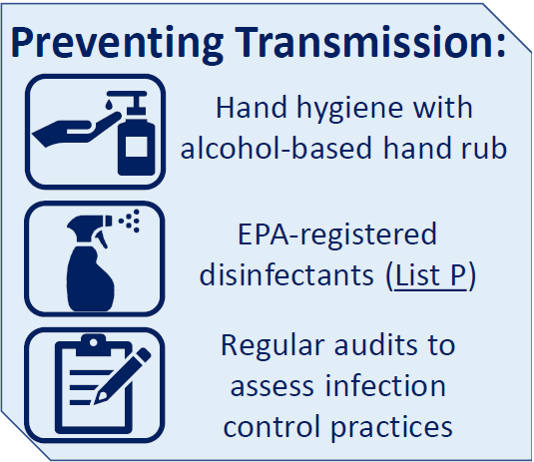
Infection Prevention and Control for Candida auris
Notes:
Healthcare workers can carry C. auris on their hands after care if proper HH is not adhered to. Healthcare workers could then carry the organism to other patients thus continuing the transmission. HH is crucial in breaking the chain of transmission
EPA- registered disinfectants on List P have verified kill claims against C. auris and should be used facility wide. If List P products are not available, products on List K (those with a C. diff kill claim) would be appropriate substitutes.
Use of PPE to care for residents is also an infection prevention and control measure for C. auris. Patients should either be placed on contact precautions or enhanced barrier precautions depending on the circumstances, healthcare setting, and facility’s policies and procedures.
Regularly assessing and providing feedback to front line staff on adherence to these infection prevention and control practices ensures the highest level of patient safety and care.

Slide 22
Hand Hygiene
Follow standard hand hygiene practices.
Alcohol-based hand sanitizer (ABHS) preferred.
Gloves are not a substitute for hand hygiene.
Notes:
When caring for patients with C. auris, healthcare personnel should follow standard hand hygiene practices.
Alcohol-based hand sanitizer (ABHS) is the preferred hand hygiene method for C. auris when hands are not visibly soiled.
If hands are visibly soiled, wash with soap and water.
Wearing gloves is not a substitute for hand hygiene.
(Centers for Disease Control and Prevention, 2022)

Slide 23
5 Moments of Hand Hygiene
Notes:
The five moments for hand hygiene is a concept that provides standardization on effective hand hygiene practices. These five moments distinguish when hand hygiene must be performed in the healthcare setting. All healthcare personnel are responsible for conducting hand hygiene at the appropriate times to stop the direct or indirect transmission of microorganism.
The five moments include:
Before touching a patient
Before clean/aseptic procedure
After body fluid exposure risk
After touching a patient
After touching a patient's surroundings

Slide 24
Hand Hygiene Strategies
Promote, monitor, and provide feedback on hand hygiene.
Ensure supplies are available and accessible.
Educate staff, patients/residents, and visitors on key hand hygiene moments.

Slide 25
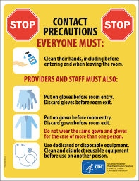
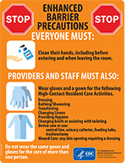
Transmission-Based Precautions (TBP)
Contact Precautions
Setting: Acute care hospitals and long-term acute care hospitals
Enhanced Barrier Precautions
Setting: Skilled nursing facilities
Notes:
The Transmission-Based Precautions and Enhanced Barrier Precautions for C. auris is similar to their use for other multidrug-resistant organisms (MDROs).
In most instances, facilities that care for patients with other MDROs or Clostridioides difficile can also care for patients with C. auris.
Facilities may contact their state or local health department if they need additional guidance on caring for patients with C. auris.
Note that decisions to discharge the patient from one level of care to another should be based on clinical criteria and the ability of the accepting facility to provide care—not on the presence or absence of infection or colonization.
(Centers for Disease Control and Prevention, 2022)

Slide 26
Acute Care Settings TBP
Place all C. auris colonized or infected patients on contact precautions.
Promote, monitor, and provide feedback on adherence to contact precautions.
Don’t discontinue contact precautions.
Flag patient chart for all future admissions – Contact Precautions should be initiated with each time.
Notes:
Healthcare providers should use Contact Precautions to manage patients with C. auris in acute care hospitals and long-term acute care hospitals.

Slide 27
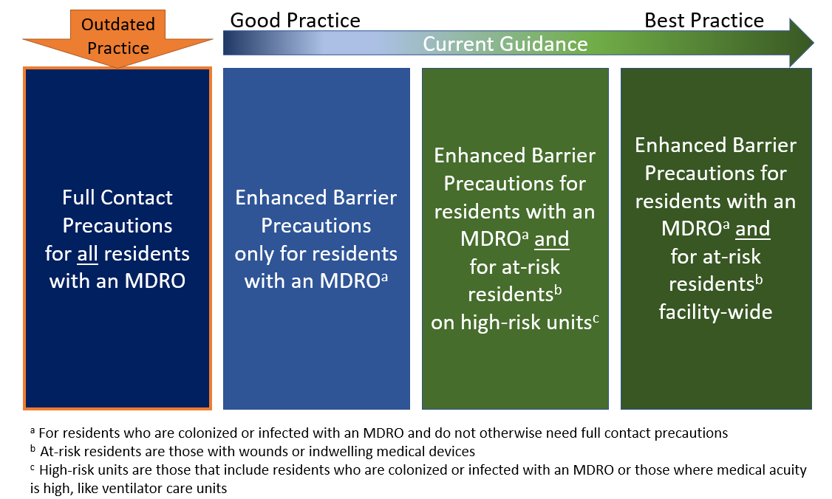
Skilled Nursing Facilities TBP
Ideally, all C. auris residents should be placed on Enhanced Barrier Precautions (EBP) unless criteria for Contact Precautions is met.
Promote, monitor, and provide feedback on adherence to TBPs.
Maintain TBPs during the resident’s stay.
Notes:
Manage residents with C. auris in nursing homes, including skilled nursing facilities, using either Contact Precautions or Enhanced Barrier Precautions, depending on the situation and local or state jurisdiction recommendations.
Refer to the CDC Guidance on Enhanced Barrier Precautions for more details about when Contact Precautions versus Enhanced Barrier Precautions would apply.
(Centers for Disease Control and Prevention, 2022)

Slide 28
Use of Cohorting
Acute Care Settings
Long-term Care Settings
Place all C. auris colonized or infected patients in single-patient rooms when possible.
Cohort colonized or infected patients and the staff.
All residents infected or colonized with C. auris should be placed in a private room.
When private rooms are unavailable, facilities may choose to cohort patients with C. auris.
Notes:
Acute Care
Place all C. auris colonized or infected patients in single-patient rooms when possible.
Cohort colonized or infected patients and the staff that care for them even if patients are in single rooms.
Long term Care
All residents infected or colonized with C. auris should be placed in a private room.
When private rooms are unavailable, facilities may choose to cohort patients with C. auris.
While it is preferable to cohort patients with the same MDROs, facilities may assign rooms based on single (or a limited number of) high-concern MDROs (e.g., C. auris or carbapenemase-producing Enterobacterales) without regard to co-colonizing organisms.
Facilities also can place patients with C. auris together in a dedicated unit or part of a unit to decrease the movement of healthcare personnel and equipment from those colonized or infected with C. auris to those who are not.
Facilities could also consider dedicating healthcare personnel (e.g., nurses, nursing assistants) who regularly care for these patients during a shift.

Slide 29
Shared Room Practices
Separation of at least 3 feet between beds and use privacy curtains.
PPE change and hand hygiene before and after interaction with each roommate.
Clean and disinfect as if each bed area were a different room.
Frequent cleaning & disinfection.
Notes:
When patients are placed in shared rooms, facilities must implement strategies to help minimize transmission between roommates.
These strategies apply to all shared rooms, regardless of patient colonization or infection status.
Maintain separation of at least 3 feet between beds.
Use privacy curtains to limit direct contact.
Have healthcare personnel change personal protective equipment (PPE), including gloves, and perform hand hygiene before and after interaction with each roommate.
Clean and disinfect as if each bed area were a different room.
Clean and disinfect any shared or reusable equipment.
Change mopheads, cleaning cloths, and other cleaning equipment between bed areas.
Clean and disinfect environmental surfaces on a more frequent schedule.

Slide 30
Environmental Cleaning
C. auris can persist on surfaces in healthcare environments.
Cultured from multiple locations in rooms, high-touch surfaces, and mobile or reusable equipment.
Notes:
C. auris has been cultured from multiple locations in patient rooms, including both high-touch surfaces, such as bedside tables and bedrails, and surfaces farther away from the patient, such as windowsills.
C. auris has also been identified on mobile or reusable equipment that is shared between patients, such as glucometers, temperature probes, blood pressure cuffs, ultrasound machines, nursing carts, and crash carts. Ideally, C. auris patients will have dedicated patient care equipment
(Centers for Disease Control and Prevention, 2022)

Slide 31
Appropriate Products
Use only products from List P (those with an EPA registered claim effective against C. auris).
If the products on List P are unavailable, facilities may use an EPA-registered hospital-grade disinfectant effective against C. difficile spores (List K).
Notes:
CDC recommends using an Environmental Protection Agency (EPA)–registered hospital-grade disinfectant effective against C. auris.
See EPA’s List P for a current list of EPA-approved products for C. auris.
If the products on List P are not accessible or otherwise suitable, facilities may use an EPA-registered hospital-grade disinfectant effective against C. difficile spores (List K) for the disinfection of C. auris.
Regardless of the product selected, it is important to follow all manufacturer’s directions for use, including applying the product for the correct contact time.
(Centers for Disease Control and Prevention, 2022)

Slide 32
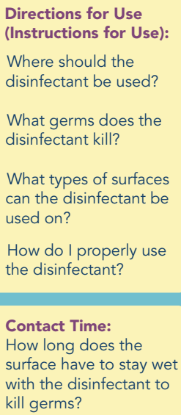
Cleaning Strategies
Conduct thorough daily and terminal cleaning of rooms and shared equipment.
Dedicate shared equipment (e.g., stethoscope) to patients/residents on TBPs.
Follow all manufacturer’s directions for use of surface disinfectants (including contact times).
Notes:
Perform thorough routine (at least daily) and terminal cleaning and disinfection of patients’ rooms and other areas where patients receive care (e.g., radiology, physical therapy) using an appropriate disinfectant.
Clean and disinfect shared or reusable equipment (e.g., ventilators, physical therapy equipment) after each use.
Label cleaned and disinfected equipment as such and store it away from dirty equipment.
Follow all manufacturer’s directions for use of surface disinfectants, and apply the product for the correct contact time.
Some products with C. albicans or fungicidal claims may not be effective against C. auris, and accumulating data indicate that products solely dependent on quaternary ammonia compounds (QACs) are NOT effective.
(Centers for Disease Control and Prevention, 2022)

Slide 33
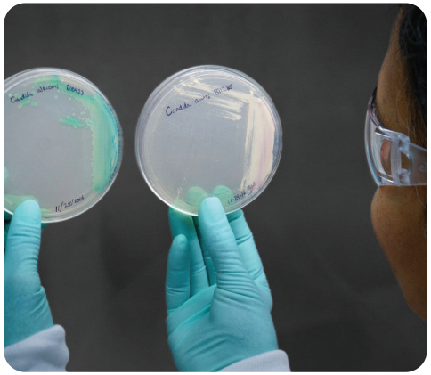
Timely Notification of Positives
Laboratories should have timely notification protocols to alert appropriate healthcare personnel of a positive C. auris specimen.
Early detection can help limit the spread of C. auris.
Notes:
Establish a protocol between Infection Prevention and Laboratory so that all stakeholders are promptly informed when C. auris is suspected.
If your laboratory is not equipped to identify C. auris, begin surveillance for the organisms that commonly represent a C. auris misidentification. See https://www.cdc.gov/ fungal/candida-auris/recommendations for common misidentifications by different yeast identification methods.

Slide 34
Active Surveillance Testing
Screen high-risk patients and residents at admission.
All yeast isolates obtained from a normally sterile site should be identified to the species level.
Contact your local health department for information about active surveillance testing for C. auris.
Notes:
CDC recommends that all yeast isolates obtained from a normally sterile site (e.g., bloodstream, cerebrospinal fluid) be identified to the species level so that appropriate initial treatment can be administered based on the typical, species-specific susceptibility patterns.
C. auris is important to identify even from a non-sterile body site because presence of C. auris in any body site can represent wider colonization, posing a risk for transmission and requiring implementation of infection control precautions.
(Centers for Disease Control and Prevention, 2021)

Slide 35
Screening Contacts
Screen when epidemiologic links are found to newly identified C. auris colonization or infections.
Coordinate screening with your local health department.
Notes:
Screening patients & residents to identify C. auris colonization is another important component for preventing spread of C. auris.
Consider screening patients who are at high risk for C. auris.
Consider a number of factors when deciding which patients to screen who have had contact with a patient with C. auris infection or colonization (referred to here as index patients).
At a minimum, screen roommates at healthcare facilities, including nursing homes, where the index patient resided in the previous month.
Ideally, identify and screen roommates of the index patient even if they were discharged from the facility.
Consider also screening patients who require higher levels of care (e.g., mechanical ventilation) and who overlapped on the ward or unit with the index patient for 3 or more days, as these patients are also at substantial risk for colonization.
(Centers for Disease Control and Prevention, 2022)
(Centers for Disease Control and Prevention, 2020)

Slide 36
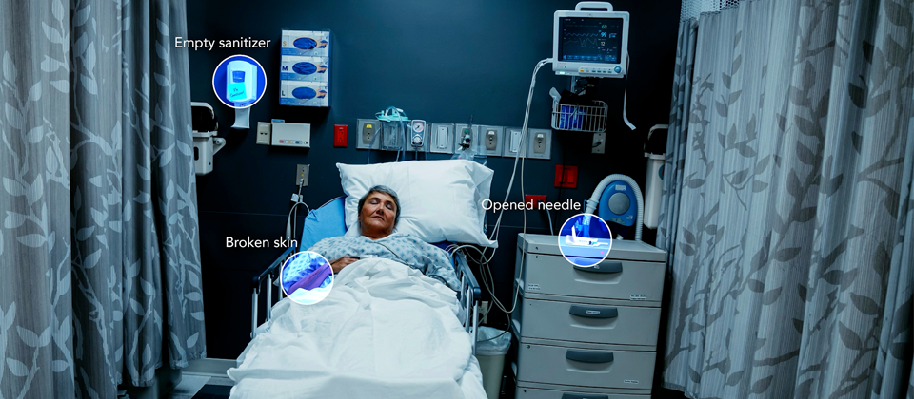
Detect Ongoing Transmission
Strongly consider more extensive screening if there is evidence or suspicion of ongoing transmission in a facility.
Consider doing a point prevalence survey.
Coordinate with local health department.
Notes:
Health departments and healthcare facilities should strongly consider performing more extensive screening, such as a point prevalence survey, if there is evidence or suspicion of ongoing transmission in a facility (e.g., C. auris detected from multiple patients through contact screening or clinical cultures, increase in infections from unidentified Candida species).
In a point prevalence survey, every patient on a given unit or floor where transmission is suspected should be screened.
Consider doing a point prevalence survey even if all known C. auris patients have been discharged or there is not evidence of transmission yet. It is better to be proactive before a larger problem occurs.
(Centers for Disease Control and Prevention, 2020)

Slide 37
Communication of C. auris Status
Notify the receiving facility or unit of C. auris infection or colonization status.
Include recommended Transmission-Based Precautions.
Interfacility IC Transfer Form
Notes:
An example of an infection control transfer form to aid this communication can be found at the top of the Healthcare-Associated Infections Prevention Toolkits web page.
(Centers for Disease Control and Prevention, 2022)

Slide 38
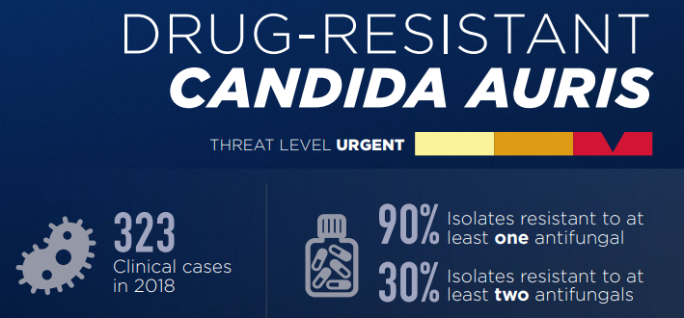
Antimicrobial Stewardship
Ensure that antimicrobials are used for appropriate durations.
Use the narrowest spectrum antimicrobial available.
Notes:
(Centers for Disease Control and Prevention, 2021)

Slide 39
Summary of Recommendations for Candida auris Containment & Prevention
Follow standard hand hygiene practices
Use EPA registered disinfectants (List P)
Use appropriate PPE, such as gown and gloves when applicable

Slide 40
All Facilities and Providers
Prepare for C. auris in your facility.
Begin surveillance.
Establish a protocol for prompt notification when C. auris is suspected.
Have a response plan.
Education for all stakeholders.
Notes:
Work with your laboratory to ensure the fungus identification method used in your facility can identify C. auris. If it cannot, know when to suspect C. auris and send suspected isolates to your state or local public health department for further identification.
Begin surveillance.
Establish a protocol with your laboratory so that your department is promptly informed when C. auris is suspected.
Know which patients are at higher risk for C. auris infection or asymptomatic colonization.
Have a response plan. Discuss recommendations for infection prevention and control of C. auris with healthcare personnel, including environmental services.
(Pennsylvania Department of Health, 2022)

Slide 41
All Facilities and Providers
Develop and maintain C. auris containment measures.
Maintain vigilance.
Evaluate prevention measures.
Contact local public health jurisdiction prior to admitting a patient known or suspected to be colonized or infected with C. auris.
Notes:
Develop and maintain C. auris action plans to assure containment measures are in place should a patient with C. auris be detected in, or transferred to the facility.
Maintain vigilance for clinical illness that could be consistent with C. auris, particularly in patients at higher risk.
Evaluate surveillance protocols with the laboratory to ensure prompt notification to the infection prevention and control program when C. auris is suspected.
Facilities that have not previously had C. auris cases should contact their local public health jurisdiction prior to admitting a patient known or suspected to be colonized or infected with C. auris.
(Pennsylvania Department of Health, 2022)

Slide 42
Facilities with C. auris cases
Review environmental health practices for effectiveness against C. auris.
Increase audits for hand hygiene, personal protective equipment (PPE) use and environmental cleaning.
Coordinate transfers and admissions of C. auris cases with local public health.
Notes:
1. Review environmental health practices for effectiveness against C. auris.
Use an EPA-registered hospital-grade disinfectant with a claim against C. auris (List P) or a product with documented effectiveness against C. auris by CDC.
If none of these products are available, an EPA-registered hospital-grade disinfectant effective against Clostridioides difficile spores (List K) can be used.
Note that many products with label claims against COVID-19 are ineffective against C. auris.
A 30-minute training on choosing the proper EPA registered disinfectant is available on TRAIN PA Course number 1102420.
2. Increase audits for hand hygiene, personal protective equipment (PPE) use and environmental cleaning on units where patients with C. auris are located.
3. Consider re-educating healthcare personnel through an in-service or retraining, especially if audits demonstrate low adherence to recommended infection prevention and control practices.
4. Report to the local public health jurisdiction when a patient colonized or infected with C. auris will be transferred from your facility to another facility; this allows public health to work with the receiving facility to provide education and ensure they are prepared to implement appropriate infection prevention and control measures.
(Pennsylvania Department of Health, 2022)

Slide 43
Resources
Healthcare Facility Toolkit for Response to Candida auris
Infection Prevention and Control for Candida auris
Interim Guidance for a Public Health Response to Contain Novel or Targeted Multidrug-resistant Organisms (MDROs)
Containment Strategy Guidelines
HAIP/AS program website

Slide 44
Fact Sheets
Drug-Resistant Candida Species
Drug-Resistant Candida auris
Candida auris: A Drug-resistant Germ That Spreads in Healthcare Facilities
Information for Infection Preventionists
Information for Laboratory Staff
Candida auris Colonization
Candida auris Testing
C. auris in Pennsylvania Infographic

Slide 45
References
Centers for Disease Control and Prevention. (2016, November 4). First cases of Candida auris reported in United States. Retrieved from cdc.gov: https://www.cdc.gov/media/releases/2016/p1104-candida-auris.html
Centers for Disease Control and Prevention. (2019, November 13). General Information about Candida auris. Retrieved from cdc.org: https://www.cdc.gov/fungal/candida-auris/candida-auris-qanda.html
Centers for Disease Control and Prevention. (2020, March 20). Information for Infection Preventionists. Retrieved from cdc.org: https://www.cdc.gov/fungal/candida-auris/fact-sheets/cdc-message-infection-experts.html
Centers for Disease Control and Prevention. (2020, May 29). Screening for Candida auris Colonization. Retrieved from cdc.org: https://www.cdc.gov/fungal/candida-auris/c-auris-screening.html
Centers for Disease Control and Prevention. (2022, December 14). Identification of Candida auris. Retrieved from cdc.gov: https://www.cdc.gov/fungal/candida-auris/identification.html
Centers for Disease Control and Prevention. (2021, March 9). Candida auris: A drug-resistant germ that spreads in healthcare facilities. Retrieved from cdc.gov/fungal/candida-auris/fact-sheets: https://www.cdc.gov/fungal/diseases/candidiasis/pdf/Candida_auris_508.pdf
Centers for Disease Control and Prevention. (2021, March 9). Drug-Resistant Candida auris. Retrieved from cdc.gov: https://www.cdc.gov/drugresistance/pdf/threats-report/candida-auris-508.pdf

Slide 46
References
Centers for Disease Control and Prevention. (2021, April 9). Healthcare Professionals FAQ. Retrieved from cdc.gov: https://www.cdc.gov/fungal/candida-auris/c-auris-health-qa.html
Centers for Disease Control and Prevention. (2022, December 27). Surveillance for Candida auris. Retrieved from cdc.org: https://www.cdc.gov/fungal/candida-auris/c-auris-surveillance.html
Centers for Disease Control and Prevention. (2023, January 17). Infection Prevention and Control for Candida auris. Retrieved from cdc.org: https://www.cdc.gov/fungal/candida-auris/c-auris-infection-control.html
Centers for Disease Control and Prevention. (2023, March 6). Containment Strategy. Retrieved from cdc.org: https://www.cdc.gov/hai/mdro-guides/containment-strategy.html
Centers for Disease Control and Prevention. (2023, February 14). Tracking Candida auris. Retrieved from cdc.org: https://www.cdc.gov/fungal/candida-auris/tracking-c-auris.html
Centers for Disease Control and Prevention. (2022, September). How to Read a Disinfectant Label. Retrieved from cdc.gov: https://www.cdc.gov/hai/pdfs/HowToReadALabel-Infographic-508.pdf
Pennsylvania Department of Health. (2022). Healthcare Facility Toolkit for Response to Candida auris. Bureau of Epidemiology. Harrisburg, PA: Pennsylvania Department of Health. Retrieved from https://www.health.pa.gov/topics/Documents/Programs/HAIP-AS/C.%20auris%20Toolkit%20-%20Healthcare%20Facilities.pdf
Sikora, A., & Zahra, F. (2022). Candida Auris. In StatPearls [Internet]. StatPearls Publishing. Retrieved from https://www.ncbi.nlm.nih.gov/books/NBK563297/
Soda, E., Forsberg, K., & Jones, H. (2021, October). The Other “C” Words: The Battle Against Multidrug-Resistant Organisms; We are in this Together. Retrieved from Mid-Atlantic MDRO Webinar Series: https://www.vdh.virginia.gov/content/uploads/sites/174/2021/10/MidAtlantic-Webinar_final.pdf
World Health Organization. (2009). Hand Hygiene Technical Reference Manual. Retrieved from who.int: https://www.who.int/teams/integrated-health-services/infection-prevention-control/hand-hygiene/monitoring-tools

Slide 47
Questions?

