Slide 1
Considerations for Mental Health and Well-Being during the COVID-19 Pandemic
May 2021
Notes:
In this module, we will talk about what you should do to protect your mental well-being, and that of your students, as schools re-open.
Welcome to this presentation on what you can do to protect your mental well-being and that of your students during the COVID-19 pandemic.

Slide 2
Disclaimer
The following information was developed to support COVID-19 prevention activities in public and non-public Pre-K-12 school settings.
This material is adapted from guidance released by the Centers for Disease Control and Prevention (CDC), and reflects currently endorsed public health best practices. The information is current as of 5/31/21.
Unless stated otherwise, the guidance being provided are recommendations and should not be considered mandates or requirements.
The training was developed in compliance to requirements for grant funding DOH received from the CDC.
Notes:
The following information was developed to support COVID-19 prevention activities in public and non-public Pre-K-12 school settings.
This material is adapted from guidance released by the Centers for Disease Control and Prevention (CDC), and reflects currently endorsed public health best practices. The information is current as of May 31, 2021.
Unless stated otherwise, the guidance being provided are recommendations and should not be considered mandates or requirements.
The training was developed in compliance to requirements for grant funding DOH received from the CDC.

Slide 3
Key messages
The pandemic has been traumatic for all of us, in big and small ways
The return to the classroom may bring added stresses
Teachers should be aware of signs of stress among themselves and among their students
Teachers and students should take time for self-care
Notes:
In this module, we’ll first acknowledge the many ways that the COVID-19 pandemic has caused trauma in our working and personal lives. We should also recognize that new stresses will arise as more and more teachers and school staff return to the classroom setting. You should be aware of the signs and symptoms of stress, both in yourselves and in your students. Fortunately, there are things that you can do to care for yourselves and to help your students cope.

Slide 4
The pandemic has been traumatic
A lot of us have experienced stress, anxiety, depression, fear, loneliness, anger, and guilt feelings
Many have lost loved ones throughout the pandemic
The pandemic has impacted all of us
All of us have had our lives and relationships disrupted
Notes:
The world-wide COVID-19 pandemic has caused trauma in numerous ways. Over a half-million people in the U.S. have died from coronavirus infection and many millions more have been made sick. Each death and serious illness impacts a family and a community. The necessary public health response to the pandemic has itself led to serious disruption of our lives, our economy, our communities, and our relationships with each other.

Slide 5
The return to the classroom may bring new stresses
Teaching—a stressful profession under the best of circumstances—became even more difficult during the pandemic
Returning to the classroom brings new stresses
Cumulatively, stresses can take a toll on your health and well-being
Illustration from CDC
Notes:
Teaching, even under the best of circumstances, is a stressful profession. Teaching became more difficult during the pandemic, whether you taught remotely or in person. More and more teachers, school staff, and students are returning to the classroom setting, facing a new set of challenges and stresses. The accumulation of stresses over the course of the pandemic can and does take a toll on your health and sense of well-being.

Slide 6
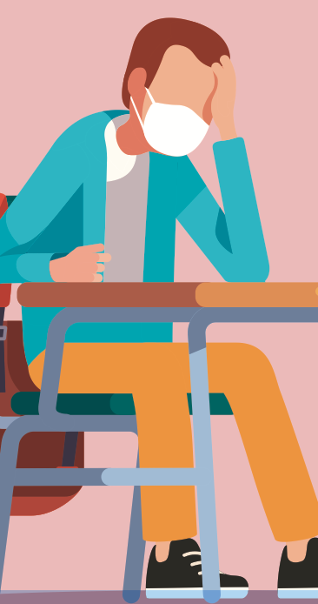
Recognizing signs of stress in yourself
Some signs of traumatic stress are:
Restlessness, fatigue or exhaustion
Irritability and anger
Trouble sleeping or relaxing
Anxiousness, worry, guilt feelings
Joylessness, sadness, depression
Stomachaches or headaches
Difficulty concentrating and confusion
Source(s): CDC. https://www.cdc.gov/coronavirus/2019-ncov/daily-life-coping/managing-stress-anxiety.html; American Federation of Teachers. COVID-19 Resources: Taking Care of Yourself in a Difficult Time. www.aft.org/coronavirus;
Illustration from CDC
Notes:
All of us should be aware of the signs and symptoms of traumatic stress. Not everyone reacts the same way to accumulated stress, but these are some of the more common signs: restlessness, fatigue or exhaustion, increased irritability, trouble sleeping, anxiety, guilt feelings, sadness or inability to find joy, depression, stomachaches and headaches, difficulty concentrating, and confusion.

Slide 7
Coping strategies to reduce stress
Get regular sleep and rest
Practice relaxation techniques
Eat healthy foods and drink a lot of water
Exercise
Stay connected to friends and loved ones
Avoid using alcohol, drugs, or food binges to cope
Illustration from CDC
Source(s): CDC. https://www.cdc.gov/coronavirus/2019-ncov/daily-life-coping/stress-coping/care-for-yourself.html
Notes:
Here are some suggestions for things that you can do to prevent or control those signs and symptoms of stress. Try to have a regular pattern of sleep, with a sufficient number of hours so that you feel rested. Practice relaxation techniques. Eat a healthy and balanced diet while drinking plenty of water. Get regular exercise. Stay connected to friends, family, loved ones, and those you consider your community. You should also avoid using alcohol, drugs, or food binges as a way to cope with stress.

Slide 8
Recognizing signs of stress in students
Signs of traumatic stress may vary by age
School-age children may feel helpless, fearful, and anxious
They may sleep poorly at night and have trouble staying awake or concentrating
Some may show regression in developmental skills
Adolescents may experience self-consciousness, shame and guilt
Sources: The National Child Traumatic Stress Network (NCTSN). Age-Related Reactions to a Traumatic Event, https://www.nctsn.org/resources/age-related-reactions-traumatic-event; Parent/Caregiver Guide to Helping Families Cope with the COVID-19 Pandemic, https://www.nctsn.org/resources/parent-caregiver-guide-to-helping-families-cope-with-the-coronavirus-disease-2019.
Notes:
Teachers should also pay attention to signs and symptoms of traumatic stress in their students. The ways that children cope with or respond to stress differ as they grow and mature. Younger children may feel helpless, fearful, and anxious. Stress may affect their ability to sleep, so they may have trouble staying awake or concentrating during the day. Some children’s skills may regress in response to traumatic stress. Older children may also show increased self-consciousness, shame or even guilt feelings.

Slide 9
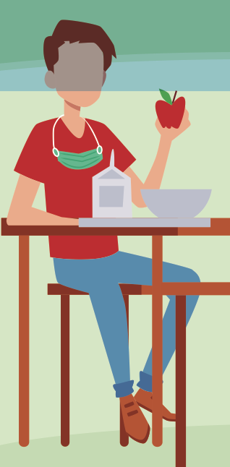
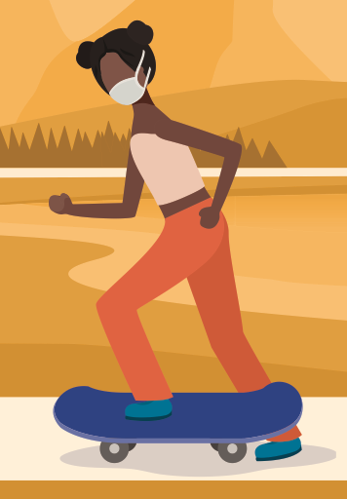
Helping your students cope with stress
Encourage your students to get regular exercise, healthy eating and good sleep habits
Remind students to spend time safely with friends
Find ways during the day to have students talk or write about how they are feeling
Seek help for students who are struggling to cope
Illustrations from CDC
Sources: CDC. https://www.cdc.gov/coronavirus/2019-ncov/downloads/mental-health/Students-Care-for-Yourself.pdf; CDC. https://www.cdc.gov/coronavirus/2019-ncov/downloads/mental-health/Teachers-Encourage-Your-Students-to-Care.pdf
Notes:
You may be able to help students cope with the accumulated stress of the pandemic by encouraging regular exercise, healthy eating, and good sleep habits. Encourage safely distanced social interactions when you can. Teachers may help students by having them write or talk about their feelings. If a student appears to be struggling, don’t hesitate to seek counseling or other mental health support for the student.

Slide 10
School support for mental health
Ask your school administrators what can be done to:
Promote awareness of employee assistance and counseling services
Adopt flexible sick leave policies to adapt to changing circumstances
Foster practices that promote mental health and wellness
Provide training to meet the demands of a changed classroom
Source: CDC. https://www.cdc.gov/coronavirus/2019-ncov/community/schools-childcare/k-12-staff.html#supporting-staff-mental-health
Notes:
Promoting good mental health and well-being is everyone’s challenge. Ask your school administrator what can be done to ensure that teachers and staff are aware of, and can take advantage of, employee assistance and counseling services. Ask how employee sick leave policies can be flexible to accommodate to the changing circumstances of teachers’ and staff members’ lives. Ask what the school can do to foster practices in and out of the classroom that allow for and promote ways to reduce or cope with stress. Ask what the school can do to ensure that teachers and staff are trained to meet the demands of a changing classroom and school environment.

Slide 11
In summary
We should acknowledge all the ways that the pandemic has caused stress and disruptions in our lives and the lives of the children and families we serve
Returning to the classroom will bring new stresses, and we need to be ready
We need to monitor ourselves and our students for signs of stress
There are things we can do to prevent or cope with stresses that arise
Notes:
To summarize, we should acknowledge the numerous ways that the pandemic has disrupted lives and caused trauma.
Returning to the classroom will bring on new stresses. We need to be aware of the signs and symptoms of stress and what we can do to reduce or prevent it, both in ourselves and in our students.

Slide 12
References and additional resources
American Federation of Teachers. COVID-19 Resources: Taking Care of Yourself in a Difficult Time. www.aft.org/coronavirus
The National Child Traumatic Stress Network (NCTSN) COVID-19 Resources, https://www.nctsn.org/what-is-child-trauma/trauma-types/disasters/pandemic-resources?page=2
Here are some of the specific fact sheets and guides from NCTSN:
Age-Related Reactions to a Traumatic Event, https://www.nctsn.org/resources/age-related-reactions-traumatic-event
Strengthening Your Resilience: Taking Care of Yourself as You Care for Others, https://www.nctsn.org/resources/strengthening-your-resilience-take-care-of-yourself-as-you-care-for-others
Parent/Caregiver Guide to Helping Families Cope with the COVID-19 Pandemic, https://www.nctsn.org/resources/parent-caregiver-guide-to-helping-families-cope-with-the-coronavirus-disease-2019
Taking Care of Yourself, https://www.nctsn.org/resources/taking-care-of-yourself
CDC. Stress and Coping During the COVID-19 Pandemic. Links to many resources: https://www.cdc.gov/coronavirus/2019-ncov/daily-life-coping/stress-coping/index.html
Notes:
Thank you for your participation. Here are selected references and some additional resources that you can explore on your own.

