Slide 1
COVID-19 testing: Considerations for pre-K-12 schools
May 2021
Notes:
In this module, we will discuss methods of testing for COVID-19.
Welcome to this presentation, where we will discuss methods of testing for COVID-19.

Slide 2
Disclaimer
The following information was developed to support COVID-19 prevention activities in public and non-public Pre-K-12 school settings.
This material is adapted from guidance released by the Centers for Disease Control and Prevention (CDC), and reflects currently endorsed public health best practices. The information is current as of 5/7/2021.
Unless stated otherwise, the guidance being provided are recommendations and should not be considered mandates or requirements.
The training was developed in compliance to requirements for grant funding the Department of Health (DOH) received from the CDC.
Notes:
The following information was developed to support COVID-19 prevention activities in public and non-public Pre-K-12 school settings.
This material is adapted from guidance released by the Centers for Disease Control and Prevention (CDC), and reflects currently endorsed public health best practices. The information is current as of 5/7/2021.
Unless stated otherwise, the guidance being provided are recommendations and should not be considered mandates or requirements.
The training was developed in compliance to requirements for grant funding the Department of Health (DOH) received from the CDC.

Slide 3
Key messages
Viral tests detect active infection with SARS-CoV-2, the virus that causes COVID-19
Antibody tests detect prior infection with the virus
There are two types of viral tests that detect active infection:
Molecular tests
Antigen tests
Testing is performed to diagnose the infection in people who are symptomatic, and to screen for infection in people who are asymptomatic
Notes:
The key takeaways from this module are:
There are viral tests to detect active infection with SARS CoV-2, the virus that causes COVID-19.
There are also antibody tests that identify prior infection with the virus.
For viral testing, there are two test options:
The first type are molecular tests for SARS CoV-2. These tests detect the genetic material (nucleic acid) of the virus. The tests amplify the amount of material in the specimen to make it easier to detect. These tests are very sensitive and conducted in laboratories.
The second type are antigen tests. These tests detect proteins from the SARS CoV-2 virus proteins. They can be performed outside of clinical laboratories, including points of care and home settings. These tests can identify people with active infection who may be highly contagious.
Testing is performed to diagnose the infection in people who are symptomatic, and to screen for infection in people who are asymptomatic.
It is important to understand the different types of tests and whether your school system plans to offer testing.

Slide 4
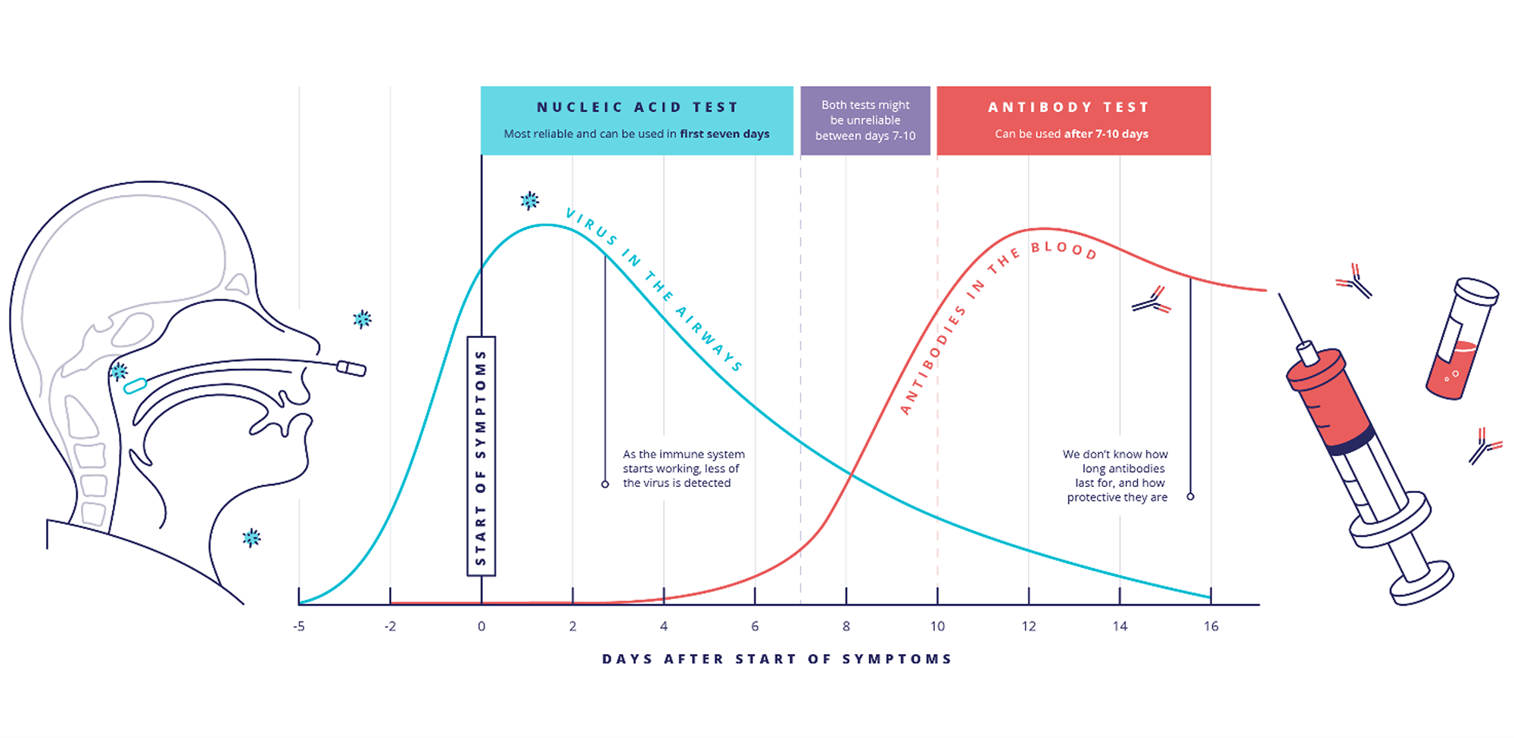
Source: https://coronavirusexplained.ukri.org/en/article/vdt0006/
Notes:
This image explains how tests are used at different points during the clinical course of COVID-19.
When people are infected with SARS CoV2, the virus that causes COVID-19, they start to shed virus in their nose and respiratory system beginning several days before they develop symptoms. They shed virus and are contagious – they can spread the virus to others – until about 10 days after they start to show symptoms.
Tests that detect virus, especially the virus’s genetic material or “nucleic acid,” can be positive from a day or two before symptom onset, until 7 to 10 days after symptoms have started.
Antibodies, which are proteins that the body makes to help us neutralize viruses and protect against future infections, are often used to help diagnose infections. When they are present in the bloodstream, it means that a person has been infected with the virus in the past. In COVID, the body begins to produce them between 4 and 10 days after symptoms start. We don’t yet know for how long antibodies will persist or last, or how protective they are against future infections.

Slide 5
Viral tests for SARS-CoV-2
Molecular tests:
Detect genetic material (nucleic acid) of the virus in respiratory specimens like saliva or through nasal swab
Amplify amount of material in the specimen to make it easier to detect
Tests are very sensitive and conducted in laboratories
Antigen tests:
Detect virus proteins in a respiratory specimen like saliva
Can be performed outside of clinical laboratories, including points of care and home settings
Can identify people with active infection who may be highly contagious
Notes:
There are two different types of tests that detect SARS CoV-2, the virus that causes COVID 19. We call these “viral” tests because they detect the virus itself.
Molecular tests detect nucleic acid, the genetic material of the virus.
Antigen tests detect virus protein.
Both tests are generally performed on respiratory specimens like saliva or nasal swabs

Slide 6
Molecular tests for SARS-CoV-2
Diagnose SARS CoV-2 infection by detecting viral genetic material
Identifies active infection
Very sensitive – can detect very small amounts of virus
Gold standard for COVID-19 detection
1-3 days turn-around
Can have “false negatives” – between 5-20%
Negative test = no virus at moment specimen was collected
Notes:
Molecular tests work by detecting nucleic acid, or the genetic material of the SARS CoV 2 virus, in clinical specimens like nasal or throat swabs, or saliva. They work by extracting the viral RNA and then amplifying it using a process called Polymerase Chain Reaction. This process generates thousands of copies, so the material is easier to detect. The test is thus very sensitive and can detect very small quantities of virus. It is considered the “gold standard” for SARS CoV 2 detection.
This test is usually performed in a clinical microbiology laboratory by trained personnel using special equipment. It can take up to 4 hours to perform the test, but results may take a day or two to come back since the specimen needs to be sent to a laboratory and processed.
Occasionally, there are “false negatives” with this test, meaning that the test can be negative even though a person has the infection. This can occur if the test is performed too early or too late in the course of infection, if a person has a form of disease that involves parts of the body other than the lung or respiratory system, or if the specimen wasn’t collected properly.
A negative result means that a person did not have the virus in their respiratory secretions at the moment when the specimen was collected. Someone exposed to the virus and incubating the infection can have a positive test hours, or days later.
The false positive rate for this test is close to zero: if the test is positive, a person is infected with the virus.

Slide 7
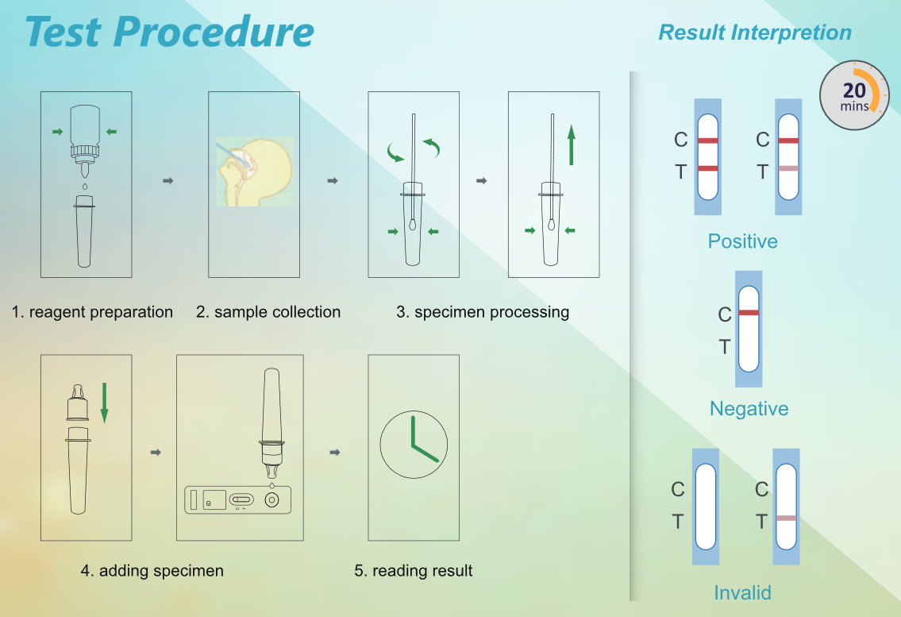
Antigen tests
Detects viral proteins of SARS-CoV-2
Identifies active infection
Less sensitive than PCR test
Detects people with a lot of virus in respiratory fluids – most contagious
56% sensitive
15-minute test
Easy to perform in ‘field’ or points of care
Source: Cambridge Bioscience
Notes:
Another way to detect the virus is through tests for antigens or proteins that are on the outside of the virus. These tests are performed on nasal swabs or saliva – the same specimens that are used for molecular tests. These tests don’t work by amplifying the amount of viral material in the specimen – they just detect what is present in the specimen. As a result, they are better at detecting large quantities of virus and are less sensitive than the molecular tests.
While these tests may incorrectly miss some infections, they are very good at identifying people with large amounts of virus in their respiratory tracts – and thus are effective at picking up people who might be very contagious.
These tests can usually be done more quickly – often in 15 minutes, and they do not need special equipment or personnel to do them. As a result, they are often available for use in doctor’s offices, and other locations outside of special clinical laboratories. Tests like these are now available for use in people’s homes.
Because of their convenience and their ability to pick up highly contagious people, many experts have recommended the use of antigen tests for screening or surveillance testing programs that are designed to identify people with asymptomatic infections who might be spreading the virus.

Slide 8
Antibody tests
Detects antibodies to SARS-CoV-2
Blood sample
Indicates prior exposure to virus
Generally, NOT used to identify active or current infection
Specific tests can distinguish between antibodies developed after infection and antibodies produced after vaccination
Notes:
Antibodies are proteins that the body’s white blood cells produce to neutralize pathogens and other threats – it is the response of the body’s immune system. They are generally produced several days into an infection and depending on the infection, can be positive for weeks to months, even years after an infection. We use them to determine if someone has been exposed to and infected with a virus in the past. We usually do not use them to identify someone with active or acute infection.
We are still learning about the body’s antibody response to COVID 19. We don’t know how effective the antibodies are with respect to how long they last, or how effective they are for neutralizing the virus. But when detected, we can generally conclude that a person has been infected in the recent past.

Slide 9
Who should be tested?
Symptomatic individuals should be tested to diagnose and confirm infection
Asymptomatic individuals who are close contacts of positive COVID-19 cases should be tested
Screening testing
Notes:
Diagnostic testing refers to when tests for COVID are used to identify infected people with symptoms. Diagnostic testing would also be used for people with recent, close exposures or contacts to cases of COVID.
Typically, molecular tests to identify the virus are used for diagnostic testing for sick individuals as well as their contacts. These tests might also be used to investigate clusters or outbreaks of COVID that are associated with a facility or school.

Slide 10
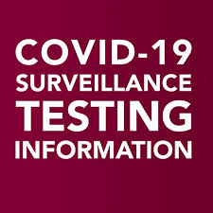
What is screening testing?
Screening testing (also called surveillance testing) is done to identify infections in asymptomatic individuals
Screening testing identifies infection in asymptomatic individuals to prevent transmission
Molecular or antigen testing can be used for screening testing
Can include entire community or sample of population
Repeated testing (1-2 times weekly)
May be used in K-12 schools to prevent spread of COVID-19
Notes:
Screening test, also called surveillance testing, is intended to identify asymptomatic individuals who are infected but may not realize it. These people may be contagious, so identifying them allows them to take measures to prevent further transmission. In addition, their contacts can be identified and tested – as these individuals may also have infection but not be aware of it.
Screening is performed using viral tests – either molecular or antigen testing.
Generally, testing is performed on an entire population or a sample or subset of a community or population, either once or twice weekly.
Many colleges and universities are utilizing screening or surveillance testing, as are many sports teams. There are K-12 school systems that are considering using screening tests as an additional strategy for preventing COVID-19, screening either teachers and staff, and/or students. The CDC considers screening tests to be something that schools should consider, in addition to the core mitigation strategies to prevent the spread of SARS CoV 2 in schools such as masking, physical distancing, handwashing and respiratory etiquette, cleaning, isolation of infected individuals and tracing and quarantining their contacts.
REF: https://www.cdc.gov/coronavirus/2019-ncov/community/schools-childcare/operation-strategy.html#tbl-2footnote-4

Slide 11
Testing in K-12 schools
Conducting COVID-19 testing in schools may prevent transmission among students and staff
Ask your school administrator about your school’s or district’s policies related to contact tracing
Notes:
Inquire with your principal or superintendent about testing strategies that are being considered for your school.
Understand the meaning of positive and negative test results and how testing will be used in your school.
Ask your school administrator about your school’s or district’s policies related to contact tracing and how your school works with the Pennsylvania Department of Health or your local health department.

Slide 12
Useful resources
Testing:
https://www.cdc.gov/coronavirus/2019-ncov/community/schools-childcare/k-12-testing.html
Contact tracing:
https://www.cdc.gov/coronavirus/2019-ncov/community/schools-childcare/contact-tracing.html
https://studentprivacy.ed.gov/resources/ferpa-and-coronavirus-disease-2019-covid-19
Notes:
These resources from the Centers for Disease Control and Prevention provide additional information on testing and on contact tracing.
This concludes this presentation on testing for COVID-19. Thank you for your attention to this material. For more information, please see these listed references.

