Slide 1

Syringe-Based EPINEPHrine Administration:
Education for Pennsylvania EMTs
Notes:
Welcome the syringe-based epinephrine administration education program for Pennsylvania emergency medical technicians.
This is an optional program for those EMTs whose agency medical director has authorized the use of syringe-based epinephrine administration.

Slide 2
The Pennsylvania Emergency Health Services Council serves as the advisory board to the Pennsylvania Department of Health on all matters related to emergency medical services.
The administration of EPINEPHrine using an alternative device to the traditional auto-injector is an initiative by the Council’s statewide medical advisory committee, which is comprised primarily of the regional medical director and approved by the board of directors.
The education program that follows was designed with the input and review of the statewide medical advisory committee and other stakeholders. It is the first of a two-part education process, which will conclude with a practical skills lab conducted by the agency medical director.
Notes:
This program was produced by the Pennsylvania Emergency Health Services Council (PEHSC), in cooperation with the Pennsylvania Department of Health, Bureau of Emergency Medical Services.
PEHSC serves as the advisory board to the Pennsylvania Department of Health on all matters related to emergency medical services.
The education presented today was reviewed of the PEHSC Medical Advisory Committee, which is comprised primarily of the 13 regional medical directors.
This is a two-part program, following completion of this presentation, you will engage with your agency medical director to complete the practical skills portion.

Slide 3
Course Objectives
Provide a rationale for syringe-based EPINEPHrine administration vs. auto injector
Review anaphylaxis pathophysiology
Review basic EPINEPHrine pharmacology
Review safe medication administration practices
Demonstrate medication administration procedure
Notes:
The course objectives include:
[READ OBJECTIVES]

Slide 4
Why Syringe-Based EPINEPHrine?
Rising cost of auto-injector devices
  $400 to $600 per vehicle
  2-year expiration date and low frequency of use
  With appropriate education, EMTs can safely administer EPINEPHrine using a dose-limited syringe
  Significant savings at both EMS agency and system level
Notes:
The rising cost of auto-injector devices has been an issue in EMS for many years. It’s estimated to cost between $400-$600 per EMS vehicle to carry EPINEPHrine auto-injectors. Increased operating costs and stagnant reimbursement has made carrying these devices difficult, if not impossible.
It’s important to note, the high costs of these devices is not because of the medication itself, but in the auto-injector technology.
With proper education, EMTs can safely administer EPINEPHhrine by syringe, thereby producing significant savings for the EMS agency.

Slide 5
History of Syringe EPINEPHrine Kits
King County, Washington (2014)
  3500 EMTs trained
  No injuries to providers
  No reported medication administration errors or bad patient outcomes
  First year system savings estimated to be $150,000
  Other states with similar programs include: New York, West Virginia, Florida, Alaska and Montana
Notes:
The first use of syringe-based epinephrine by EMTs occurred in King County, in the State of Washington, where some 3,500 EMTs received what has come to be known as “Check-n-Inject.”
During the first year of use, there were no medication errors or negative outcomes related to syringe-based epinephrine.
Following the King County pilot, other states included this program in their scope of practice – including, New York, West Virginia, Florida, Alaska and Montana.

Slide 6
Anaphylaxis Overview
A serious and systemic allergic reaction
  Multi-system involvement
  Rapid onset
  Upper airway swelling
  Respiratory distress symptoms
  Shock
  If left untreated, anaphylaxis can cause DEATH!
Notes:
Anaphylaxis is a serious and potentially life-threatening condition with multi-system involvement that requires immediate intervention.
Signs and symptoms include:
Rapid onset
Respiratory distress
Wheezing or decreased air movement on auscultation
Facial and/or upper airway swelling
Significant rash or hives
Hypotension and tachycardia associated with signs of shock

Slide 7
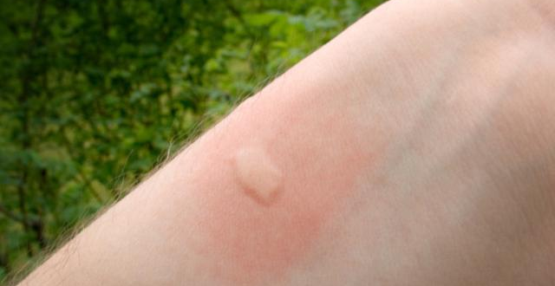
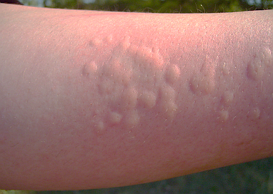

Anaphylaxis is NOT…
An insect bite with localized swelling and itching
A runny nose
Sneezing
Watery eyes
Hives/Rash without respiratory distress
Notes:
Just as important to recognize a patient experiencing anaphylaxis, you must be able to differentiate between the acutely ill patient and one experiencing a mild, local reaction from exposure to an allergen.
Signs and symptoms of a mild or localized allergic reaction include:
[Read bullets from slide]
Again, epinephrine in not indicated for patients experiencing mild or localized allergic reaction.
These patients should be monitored to ensure a mild reaction has not progressed to a more serious anaphylactic reaction.

Slide 8





Common Causes of Anaphylaxis
Foods
  Nuts
  Shellfish
  Fruits
  Insects
    Bees
    Spiders
    Medications/Latex
      Antibiotics
Notes:
These are some of the more common causes a of serious allergic reaction. A couple of noteworthy points:
A person can have been previously exposed to an allergen and had no reaction. The first exposure triggers the body’s sensitivity, subsequent exposures can trigger an allergic or anaphylactic reaction.
If a medication is suspected as the source, bring the medication to the hospital for further review.

Slide 9

Signs & Symptoms
Respiratory distress and wheezing or stridor
Swollen tongue and/or lips
Difficulty swallowing
Hypotension
Tachycardia
Extensive hives with itching
Notes:
Let’s take moment to review the most common signs and symptoms of an anaphylactic reaction:
[Read the s/s from the slide]
Remember, it’s the systemic involvement:
Respiratory distress
Airway edema
Hypotension
Tachycardia
which indicates anaphylaxis vs. a local allergic reaction.

Slide 10

Case Study 1
35 yo male was working in his garden when stung by a bee
Experienced pain, swelling and itching at the sting site and is concerned he is having an allergic reaction
No known allergy to bee stings
No of shortness of breath w/ clear lungs fields
Visible hives
Appears very anxious
Vital signs on EMS arrival:
HR 90
RR 24
BP 122/80
SPO2 98% on room air
Notes:
Let’s take look at a few cases to determine whether the patient is experiencing anaphylaxis and may require epinephrine. Or, are they just experiencing a non-life threatening local or allergic reaction.
[Read case]
Anaphylaxis or allergic reaction??
Those who said ALLERGIC REACTION are correct based on:
This is simple bee sting with local trauma
Visible hives but:
No shortness of breath or wheezing and;
Normal vital signs
This patient does not require epinephrine – follow Protocol 411 (Note 1) for treatment options

Slide 11
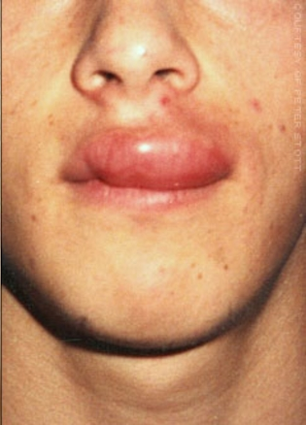
Case Study 2
15 yo male at summer camp when stung by a bee
Presents to camp nurse 30 minutes later
Patient has known allergy to bee stings
Painful swelling at sting site
Complains of shortness of breath with audible wheezing
Nurse administered patient prescribed epi auto-injector before calling 911
Vital signs on EMS arrival:
HR 96
RR 24
BP 132/64
SPO2 96% - lungs now clear
Notes:
[Read case]
Anaphylaxis or allergic reaction??
Those who said ANAPHYLAXIS are correct based on:
Shortness of breath with wheezing present on auscultation
After epi – dyspnea and wheezing resolved.
No need for EMS epi administration unless symptoms return

Slide 12

Case Study 3
79-year-old female with allergy to shellfish
Taken out to dinner – no known exposure
Developed hives over face, chest and back
Took OTC Benadryl
EMS called after patient started to experience dyspnea
Vital signs on EMS arrival:
HR 106
RR 36
BP 102/52
SPO2 88% with shallow respirations and audible wheezes
Notes:
[Read case information]
Anaphylaxis or allergic reaction??
If you said, ANAPHYLAXIS, you are correct based on:
Respiratory distress with wheezing and low pulse ox
Tachycardia with borderline hypotension
This is an example of rapid progression from what initially appeared to be a local reaction that progressed to anaphylaxis.

Slide 13
Case Study 4
3-year-old female felt sick after eating strawberries at a picnic
Rash noted around mouth
Over the next 15 minutes, patient becomes pale and has < LOC; only responds to painful stimuli
Vital signs on EMS arrival:
HR: 120
RR: 10
BP: capillary refill >4 sec
SPO2: 85% with almost barely audible breath sounds and wheezes noted
Notes:
[Read Case Information]
Anaphylaxis or allergic reaction??
If you said ANAPHYLAXIS, you are correct based on:
Rash
Altered level of consciousness
Low pulse ox w/ need for airway control and IPPV w/ O2
Delayed capillary refill indicating hypoperfusion associated shock
This case demonstrates a patient in an extremely critical situation that requires immediate intervention to prevent complete cardiovascular collapse.

Slide 14
Treatment
Dispatch ALS if not responding (Protocol 210)
Perform assessment (Protocol 201)
Monitor SPO2 (Protocol 226)
Administer oxygen if SPO2 <95% (Protocol 202)
If anaphylaxis suspected, administer EPINEPHrine using 1mg/ml concentration (Protocol 411)
  Adult Dose 0.3 mg (0.3ml) IM
  Pediatric Dose 0.15 mg* (0.15ml) IM
  *A pediatric patient is defined as a child < 8 y.o. or < 55lbs (25 kg) body weight
Notes:
Treatment goals for a patient experiencing acute anaphylaxis are:
Ensuring an open airway
Supplemental O2 if pulse ox is <95% or if the patient shows signs of hypoxia
Use a BVM as needed to support effective ventilation
Administration of intramuscular epinephrine in a concentration of 1 mg/ml.
Adult dose is 0.3 mg (0.3 ml)
Peds Dose is 0.15 mg (0.15 ml)
Ensure an advance life support unit has been dispatched

Slide 15
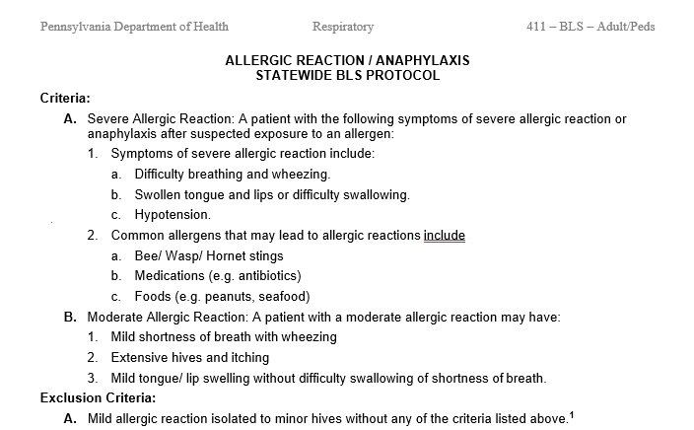
PA BLS Protocol 411
Notes:
In the 2023 BLS protocol update, the optional use of syringe-based epinephrine was included in Protocol 411, Allergic Reaction and Anaphylaxis.
Administration of epinephrine is only indicated for patient with signs and symptoms of an anaphylactic reaction.
Regardless of the method of administration, epinephrine is not indicated in patients presenting with a mild, localized allergic reaction.

Slide 16
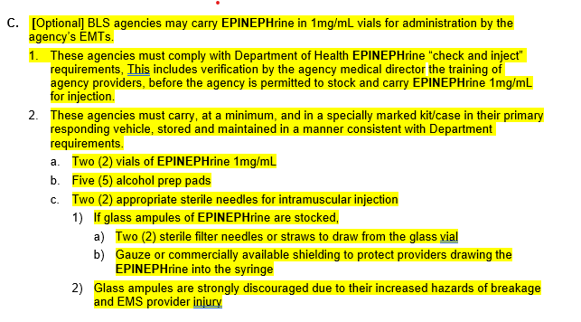
PA BLS Protocol 411
Notes:
Protocol 411 also contains the required elements of a Check-n-Inject kit, whether purchased from a vendor or assembled in-house.
The centerpiece of the kit is a dose-limited 1 ml syringe that clearly indicates both the adult and pediatric dose of epinephrine. This specialized syringe helps to the reduce the incidence of over or under dose.

Slide 17
EPINEPHrine
Synthetic version of naturally occurring adrenalin
Dilates bronchioles to ease breathing
Increases heart rate and strength of contractions
Increases blood pressure
Note: Due to the cardiovascular effects of epinephrine, consider medical command consult before administering to a patient with a history of cardiovascular disease or ≥ 55 y.o.
Notes:
[Read slide information]
As demonstrated in Case 3, epinephrine is critically important treat bronchoconstriction with poor air exchange and hypotension demonstrated by decreased blood pressure or significantly delayed capillary refill.
As a special note: If your patient is over 55 yo, and with a history of cardiovascular disease, and time permits, consider consulting medical command prior to administering epi due to its known cardiovascular effects. However, a hx of cardiovascular disease is not an absolute contraindication for the administration of EPINEPHrine in acute anaphylaxis.

Slide 18
EPINEPHrine
Onset of action
  Typically, 90 seconds in a healthy patient
  In anaphylaxis, may take 3-5 minutes
  If no change after 5 minutes, contact medical command for possible 2nd dose
  Duration of action
    Typically, 1-4 hours
    Possible side effects
      Palpitations
      Anxiousness and/or Tremors
      Headache
Notes:
Let’s review the onset, duration and possible side effects associated with epinephrine… [read slide]

Slide 19
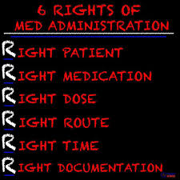
Medication Administration
Notes:
Even though as an EMT you are only authorized to administer a single medication by injection, it’s an appropriate time to introduce you to the “6 Rights of Med Administration.”
Patient – is the medication appropriate for this patient?
Medication – ensure you are administering epi 1 mg/1 ml
Dose – Adults 0.3 mg (0.3 ml) and Peds 0.15 mg (0.15 ml)
Route – Epi is administered by an intramuscular injection
Time – If anaphylaxis is suspected, this is a time-critical treatment
Documentation – record in the PCR the date, time, medication, dosage administered, route of administration and how the patient reacted to the treatment, i.e., improved, remained the same or deteriorated

Slide 20
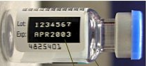
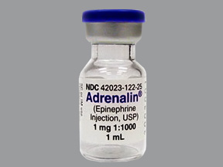
Medication Administration
1. Verify Medication
EPINEPHrine 1mg in 1 ml container
Expiration Date
Contents of vial should be clear
Notes:
Like any medical procedure, when administering any medication, the provider has certain responsibilities, let’s look at them step by step.
[Read slide]
Even though the epinephrine you will be administering is part of a pre-prepared kit, it is still your responsibility to verify that you have the correct medication and concentration, which is 1mg in 1ml of fluid.

Slide 21
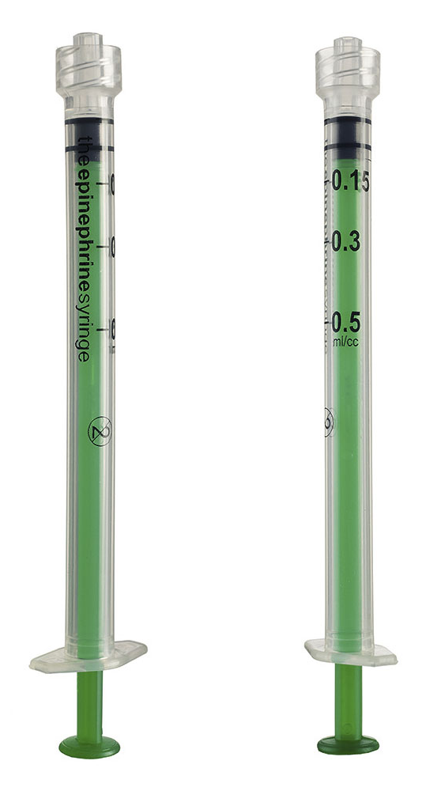
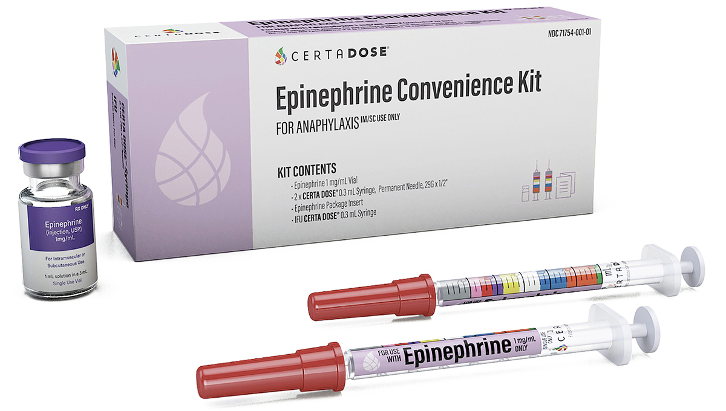
Medication Administration
A dose-limiting syringe that is specifically marked for adult or peds epinephrine is required for this method of administration.
Pre-packaged kits are also available which contain the medication, special syringe and other ancillary supplies.
Peds
Adult
Notes:
The epi kits you will be using contain a dose-limiting syringe that is clearly marked for both the adult epi dose (0.3mg) and the pediatric dose (0.15mg). These special syringes are required to be part of any commercially purchased or in-house assembled kit.

Slide 22
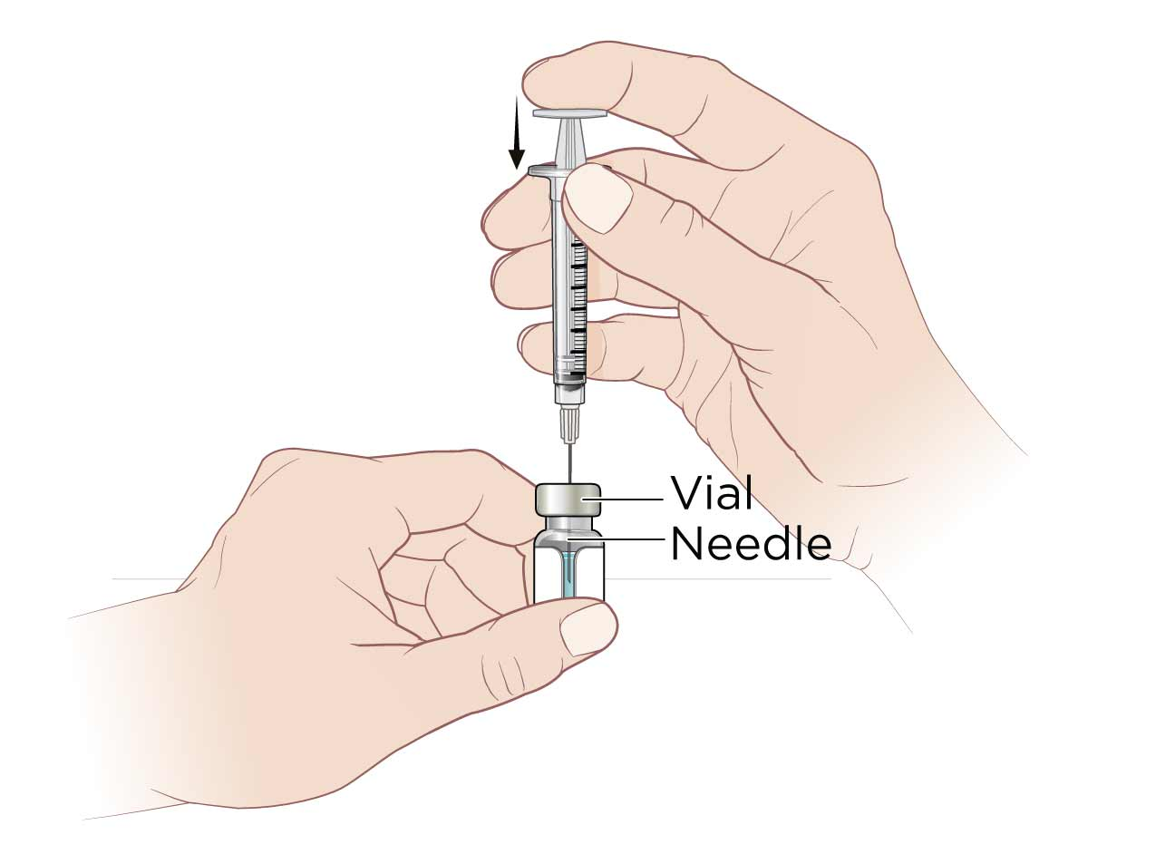
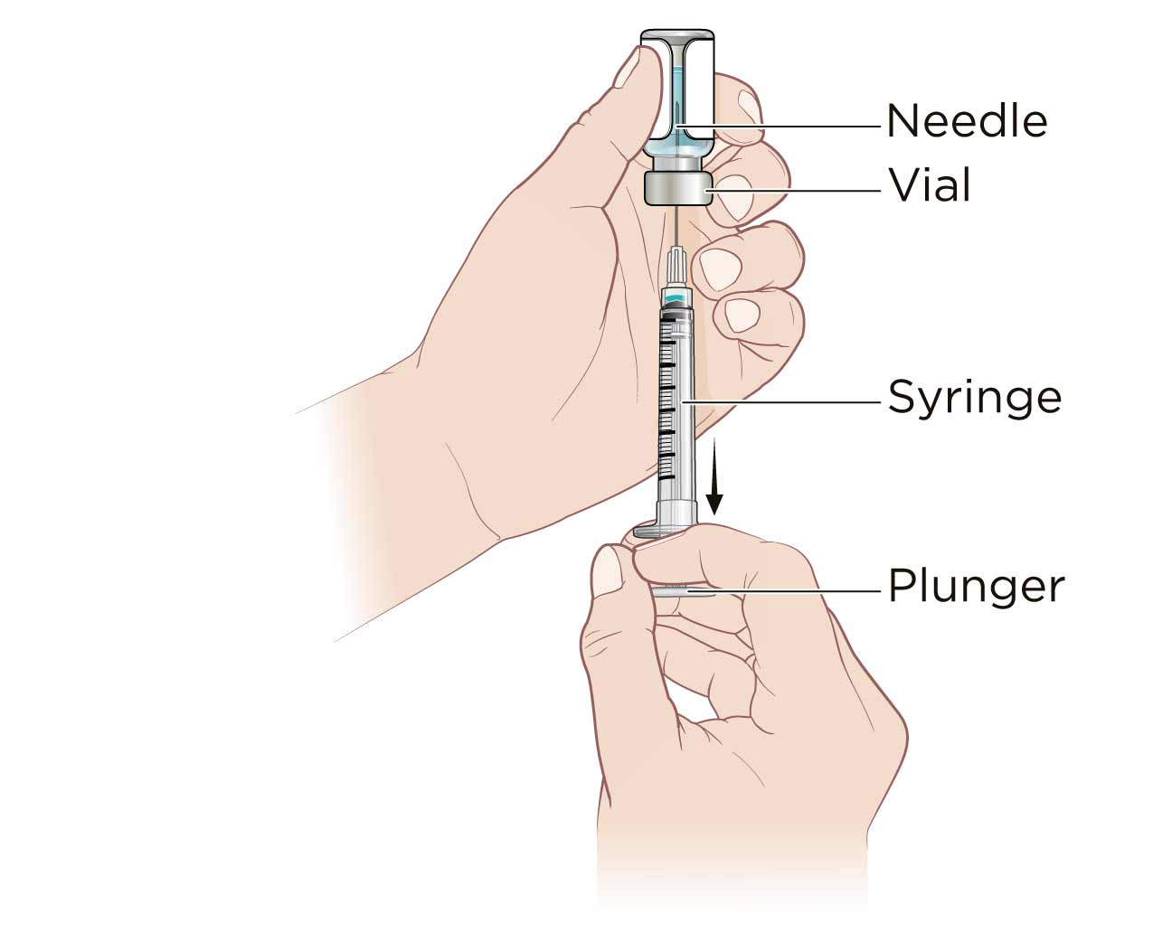
Medication Administration
2. Draw up epinephrine with a 1ml syringe
Remove protective cap from the vial, clean rubber stopper with alcohol pad
Place vial on flat surface
Instill air in the vial equal to amount of fluid to be removed
With the needle still in vial, invert both syringe and vial together
Withdraw desired amount of medication
Expel any bubble and excess liquid
To ensure penetration of the muscle, use a a needle that is 1-1 ½ inches in length
Notes:
[Read slide]

Slide 23
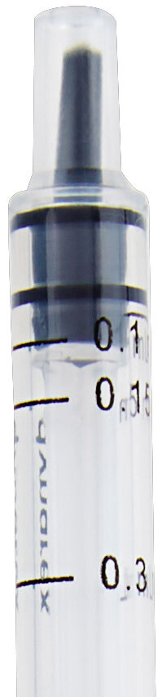
Medication Administration
Using Dose-Limiting Syringe
3. Verify dosage
ADULT:
0.3 mg (0.3ml)
PEDIATRIC:
0.15 mg (0.15ml)
0.15ml
(Half of Adult Dose: for children < 8 yo or < 55lbs/25kg)
0.3ml
Notes:
This slide shows a close-up of the adult and peds markings on a dose-limited syringe. Prior to administration, the provider must verify that the desired volume of medication is present in the syringe.

Slide 24
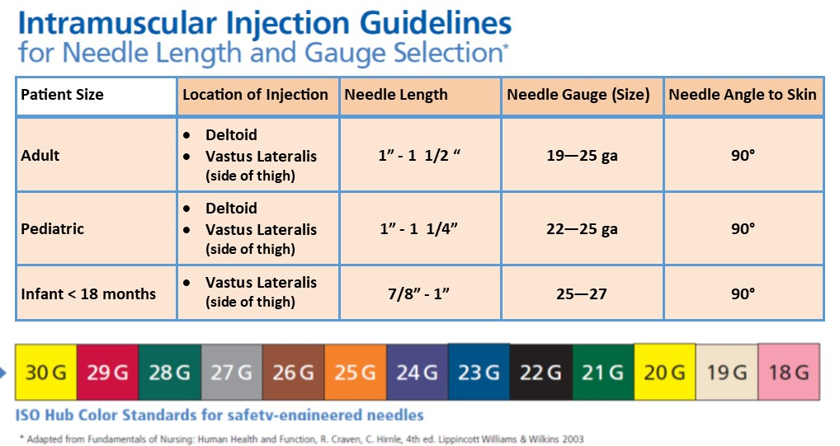
Medication Administration
Notes:
This chart provides a reference for needle size and length for an intramuscular injection in an adult, child or infant.
You will find that the diameter, or gauge of the needle is associated with a particular shaft length based on the needle’s common uses.

Slide 25
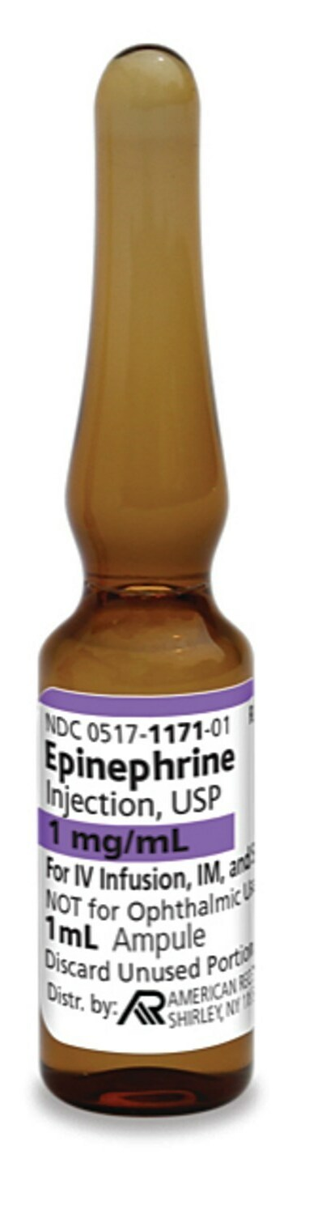
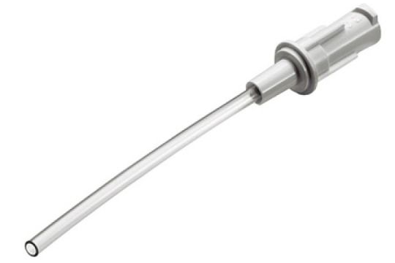
Medication Administration
If epi is supplied in a glass ampule, caution must be used when detaching the top of the container to avoid injury from sharp or jagged glass.
A barrier, such as an alcohol prep pad or gauze sponge should be used when detaching the ampule’s top.
Ampules are not recommended for BLS providers.
A filter straw (below) or filter needle should be used to withdraw the medication first, then switch to an appropriate size hypodermic needle for administration.
The filter device will capture any glass fragments that may fall into the ampule when the top is detached.
Notes:
As an alternative to a vial, epinephrine is sometime supplied in a glass ampule. When the neck of the ampule is snapped off the body of the container, a sharp and/or jagged edge can be produced.
Although this type of container is common in healthcare, it is not recommended for this program due to the increased chance of provider injury.
Should you find yourself in a position that requires the use of an ampule, a filter straw or filter needle should be used to withdraw the medication, then switched out for a regular hypodermic needle. Using a filter ensures no glass particles are drawn up with the medication.

Slide 26
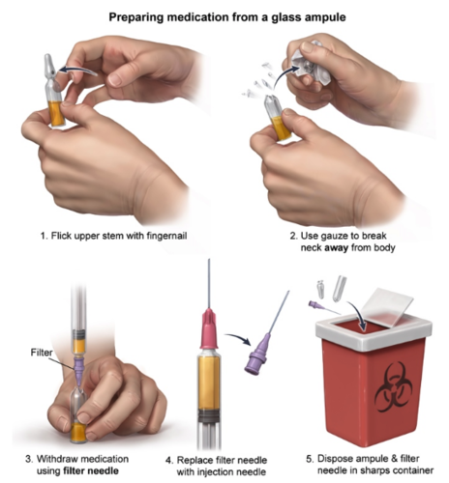
Medication Administration
Notes:
This slide demonstrates the proper technique for assessing and withdrawing medication from an ampule.
Of special note, the provider should place a safety barrier around the top of the ampule before breaking it at the neck. Common barriers include an alcohol prep pad or gauze pad. Also, be sure to discard the separated parts of the ampule in a sharps box as soon as possible to prevent injury.

Slide 27
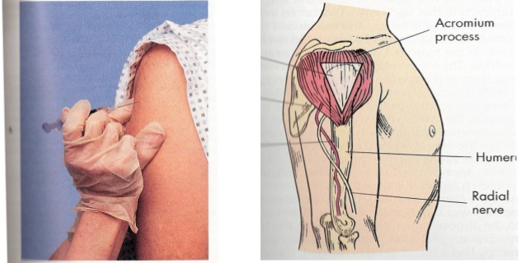
Medication Administration
4. Select Injection Site
Pediatrics (preteen/teenager)
Adults
Deltoid
Notes:
The deltoid muscle, located in the upper arm, extending from the shoulder to the mid-humeral region, is the most common site for an intramuscular injection. The graphic on the right side of the screen notes the injection target area.
The skin is stretched over the humerus to ensure penetration into the deltoid muscle. The needle is fully inserted at 90 degrees to the skin.

Slide 28
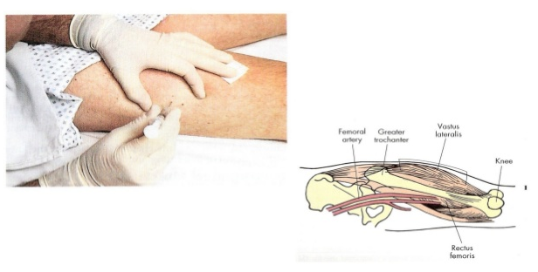
Medication Administration
Pediatrics (infant/toddler)
Adults
Adults w/ little arm muscle
Vastus Lateralis
(Lateral Thigh)
Notes:
Another injection site is the vastus lateralis, which is located anterior-lateral portion of the thigh as noted in the graphic. This is the preferred injection site in infants, children and adults that lack adequate deltoid muscle mass to accommodate an injection.
The injection procedure is consistent with that previously described using the deltoid site.

Slide 29
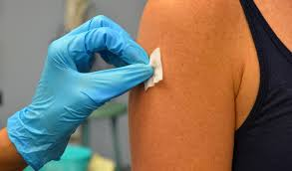
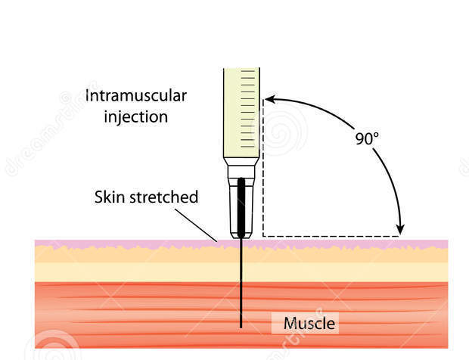
Medication Administration
5. Inject
To ensure penetration of the muscle, use a needle 1-1 ½ inches in length
Cleanse injection site with an alcohol prep pad using circular motion working from center outward
Stretch the skin taut over inject site and insert needle at 90º angle
Pull back on plunger to aspirate for blood. If blood is noted in syringe barrel, withdraw needle and prepare a new syringe and different injection site
If no blood, inject medication; when complete withdraw needle and dispose of syringe in sharps container
Notes:
Now, let’s administer the injection…
[Read slide]
Immediately after the injection, safely dispose of the needle and syringe in an approved sharps box.
Avoid recapping the needle if possible. If recapping is necessary, do so by placing the needle cap on a flat surface and guiding needle into the cap. Under no circumstances should your free hand be near needle until it is safely in the cap.
Remember…you and you alone are responsible for your sharps and any injuries that occur due to improper handling!

Slide 30
Medication Administration
6. Document
Time
Medication Name → EPINEPHrine
Concentration → 1mg/ml
Amount Administered → 0.3mg or 0.15mg
Injection Site → L/R Deltoid or Lateral Thigh
Patient response to medication
Notes:
Post injection, during completion of the PCR, document the following elements using the predefined fields and/or text box(s) provided by the software vendor.
[Read slide]

Slide 31
Medication Administration
7. Monitor Patient
Anticipated response to medication
Common side effects
  Anxiousness
  Tremors
  Increases heart rate or palpitations
  Headache
  Vital Signs, SPO2 and lung sounds
  If no improvement after 5 minutes and ALS not yet on scene – contact medical command to discuss repeat dose of epinephrine
Notes:
Following the administration of any medication, it is the provider’s responsibility to monitor the patient for…
[Read slide]

Slide 32
Review
Anaphylaxis is a serious and systemic reaction
Rapid recognition and treatment is essential
Symptoms may include difficultly breathing, facial/airway swelling and shock
EPINEPHrine, a synthetic version of adrenalin, is the drug of choice in anaphylaxis
EPINEPHrine administered by a special dose-limiting syringe is an economical alternative to an auto-injector
Notes:
To review…
[Read slide]

Slide 33
References
Husain S, Nolan J, Latimer A, Eisenberg M, (2017, June) EPINEPHrine Economics. Journal of Emergency Medical Services 27-30.
Caroline N, (2013) Emergency Care in the Streets 511-520 Burlington: Jones Bartlett
2023 Pennsylvania Statewide Basic Life Support Protocols
2023 Pennsylvania Statewide Advanced Life Support Protocols
New York State “Check and Inject” EMT EPINEPHrine Program
West Virginia EMT EPINEPHrine Training Module
Notes:
[No narration]

Slide 34
Proceed to Skills Verification
with Medical Director
Notes:
This concludes the didactic portion of the Check-n-Inject education program. The final portion of the program will be an in-person skills verification session conducted by your agency medical director.
On behalf of the Pennsylvania Emergency Health Services Council and Pennsylvania Department of Health, Bureau of EMS, thank you for your time and attention.

